Slide 1
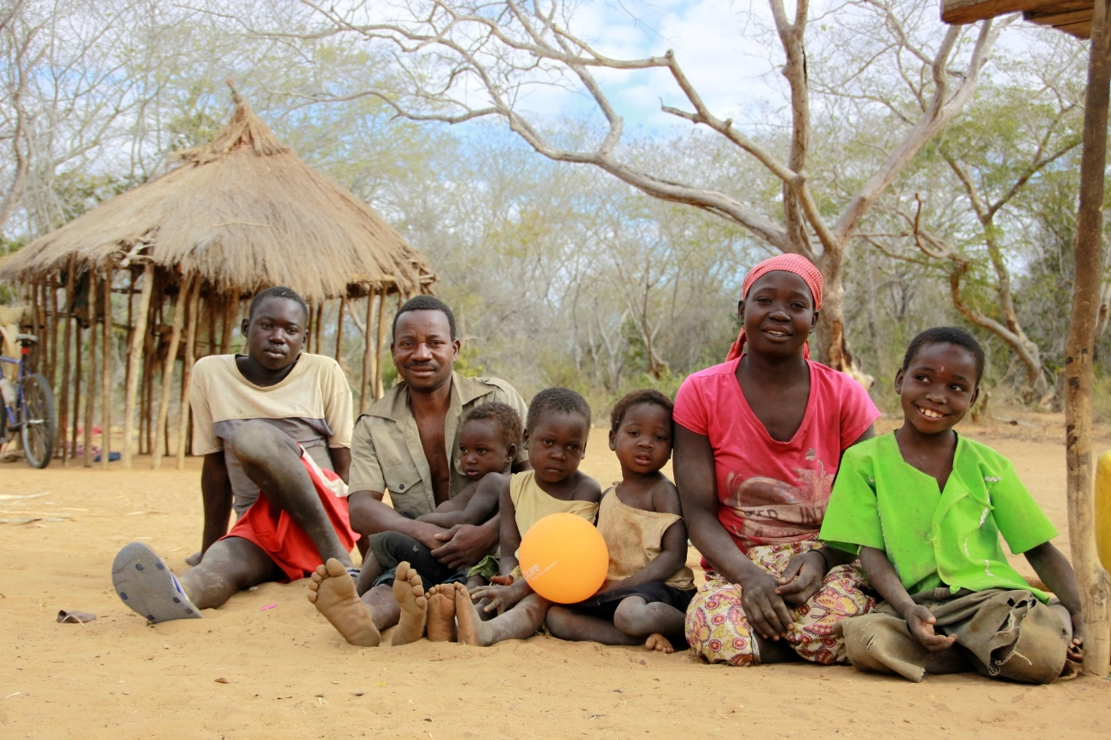
GENDER EQUALITY & CTP
Image credit: CARE

Slide 2

Acknowledgements
This session is made possible through the ongoing support of CaLP’s members.

Slide 3
Session Overview
Theoretical: Key actions for meaningful incorporation of gender equality in CTP
Practical: Apply concepts to case study
Questions

Slide 4
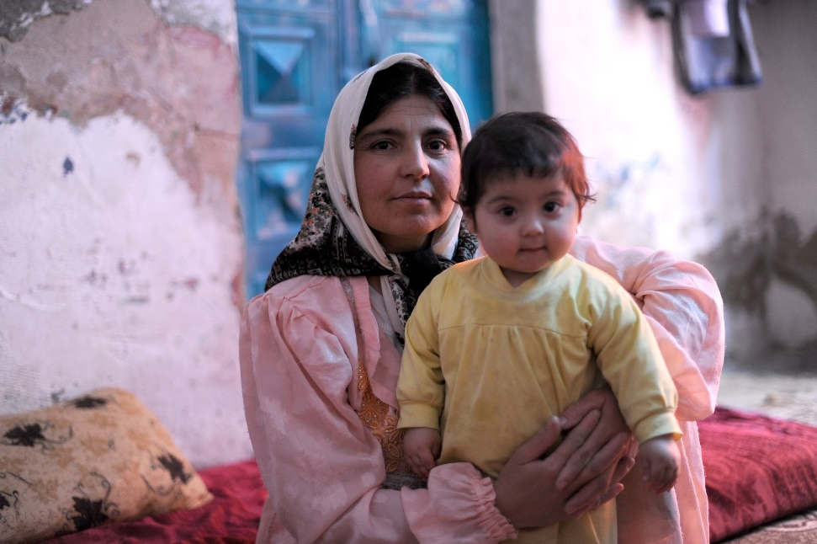
Why is this important?
Promote women’s rights, choices & reduce barrier
Strengthen local economies
Promote economic-self reliance
Shift gender relations
Image credit: CARE
Notes:
Integrating gender equality into CBI programming will achieve the following goals:
• Promote women’s rights and choices and reduce barriers and risks. The gender-specific needs can be met by tailoring the means of registration, frequency, amounts and mechanisms of transfer. For example, the timing and mechanism to distribute cash must consider women’s household care duties, or ease of movement.
• Strengthen local economies, thereby benefiting both the affected population and the host community. Cash to be spent in local markets shifts the demand of goods and services towards the needs of recipients. How women and men spend the cash leads markets to better reflect their needs and those of their dependents.
• Promote economic self-reliance. Targeted CBIs can particularly assist women entrepreneurs to start, rebuild or expand their means of economic livelihood and improve their chance of recovery, independence and future resiliency.
• Provide a shift in gender relations towards equality. Regular and consistent income to the female head of a household can improve health, education and other humanitarian outcomes for all members of the household and can strengthen women’s self-sufficiency and resilience. Some times in crisis we have an opportunity to positively impact such a shift.

Slide 5
Needs Assessment

Slide 6
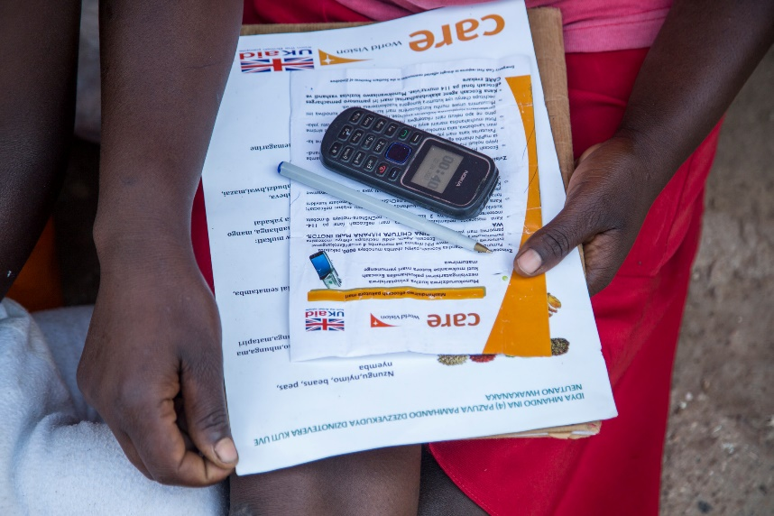
Needs Assessment
Adapt tools
Gender Analysis
SADD
Analysis of results
Image credit: CARE
Notes:
You can adapt the tools that your teams are using for needs assessments; the intention is to understand the impact of the crisis on different types of groups.
A gender analysis would start at this phase and used later in the response. IASC has rapid tool if your agency does not. Some themes the analysis looks at are population demographics, gender roles, decision making structures, protection, needs, capacities and aspirations.
Sex and age disaggregated data are a core component to a gender analysis and essential for monitoring and measuring results. It can help inform needs or challenges. Beyond age and gender it can also be used to break down income groups, ethnicity, ectra, which may have other implications.
Once you analyze your results, you are likely to see patterns within the needs, capacities and aspirations of different groups.

Slide 7
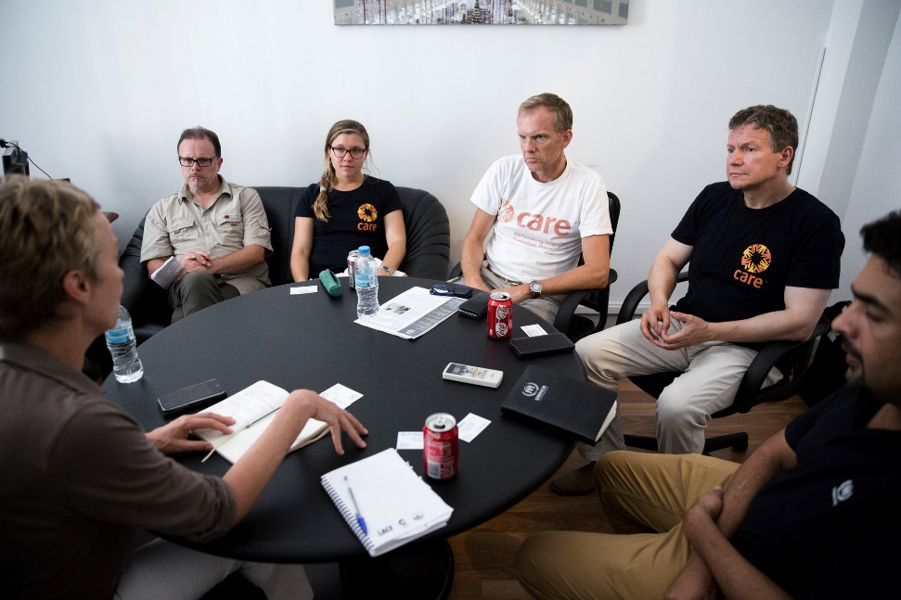

Needs Assessment: Considerations
Work with local women’s right groups
Ensure balanced team: collection & analysis
Childcare
Mind your ethics
Notes:
Some considerations good practices to consider to make your needs assessment more gender friendly are:
Work with a local women’s rights group: maybe gender or CTP are not your organization’s specialty; these types of actors will have good analysis and often can enter in dialogue more easily
Don’t forget the operational side: gender balance makes a huge difference both in data collection and analysis.
Child care is also and issue: most of the places we work you will find children along with their mothers or grandmothers. It can be distracting for the interviewers and the participants if they must also thinks about child care. Think of making provisions for a safe space where they can play under supervision.
Lastly, be careful not to probe too deeply into topics that are culturally sensitive or taboo unless you have experts on the team

Slide 8
Strategic Planning
Notes:
Here is where you can make your link through a gender analysis lens

Slide 9
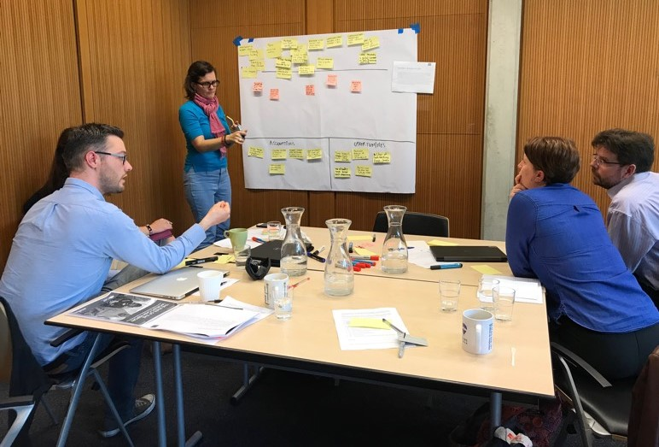
Strategic Planning
Use gender analysis questions to form your objectives, results, indicators and activities
Image credit: CARE
Notes:
At this stage you will know the needs, challenges and opportunities for CTP. By asking gender analysis questions, you can ensure that the project design takes into consideration the different needs

Slide 10
Examples Gender Analysis Questions
What kind of work is culturally acceptable for women and men?
What barriers to working do women face?
Which factors are essential to ensure safer cash transfers to women and men (e.g. amount, duration, frequency, mechanism)?
Would women, girls men and boys face new risks due to involvement in CTP?

Slide 11
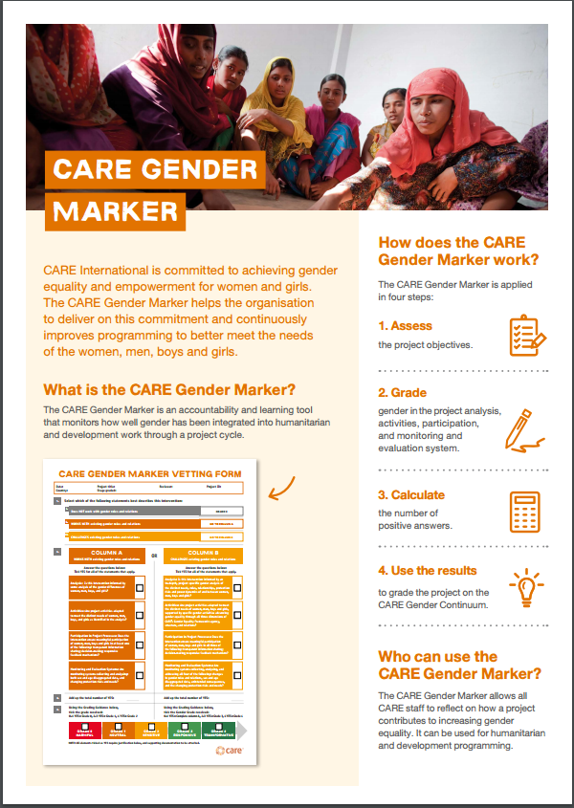
CARE Gender Marker
All humanitarian and development projects have been using the CARE Gender Marker since 2016.
Notes:
CARE’s Gender Marker tool helps teams measure the integration of gender into programming from harmful to transformative, using a simple grading system from 0 to 4. It can be used in humanitarian and development projects. The tool and guidance are publicly available in English, French, Spanish and Arabic. IASC also has the GAM-Gender with Age Marker with resrouces available online.

Slide 12
Resource Mobilization

Slide 13
Resource Mobilization
Advocate for address gaps to women, girls, men and boys
Support stakeholders with information on distinct needs
Costs may differ: communicate intention
Avoid assumptions
Show your gender marker
Notes:
Through resource mobilization is where you can make your gendered analysis shine, which can be a double added advantage: for the groups that normally could be excluded or not have their needs met and for your agency by showing an added value in programming.

Slide 14
Implementation & Monitoring

Slide 15
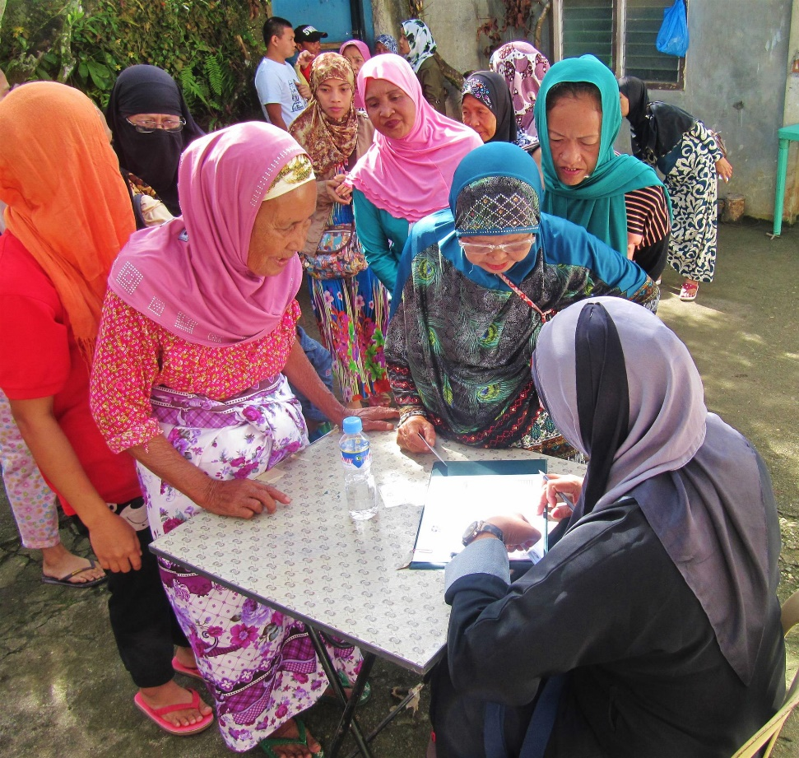
Implementation & Monitoring
Tailor activities to needs, capacities, priorities
Inform different groups on resources & how to access them
Feedback mechanisms that meet all groups’ needs
Remember team balance
Image credit: CARE
Notes:
Think of these different activities through the perspectives of the different groups

Slide 16
Peer Review & Evaluation

Slide 17
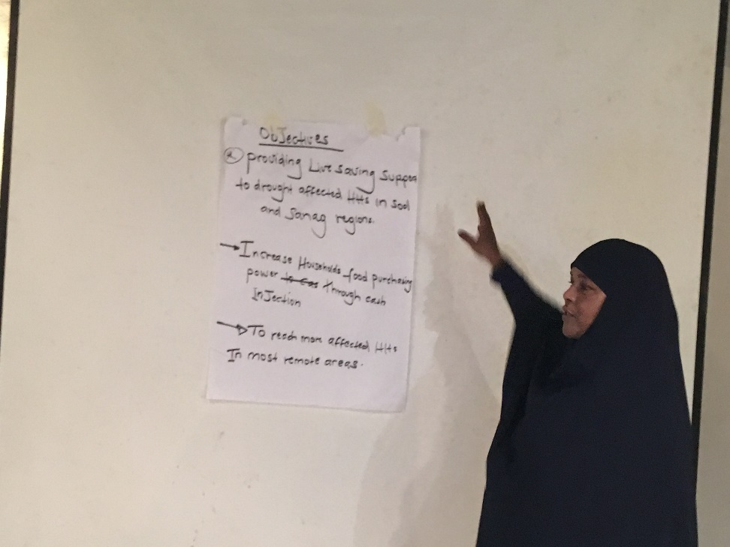
Peer Review & Evaluation
Review methodologies & processes
Equal participation
Assess gaps
Can use gender marker
Share your findings
Image credit: CARE
Notes:
During this phase, we need to review methodologies and processes to ensure that we apply good practice so that we can meaningfully assess if the response provided equal assistance to women and men. Ideally include a gender advisor or advocate to review the framework and methodology—be that advocate on your team! Consider a mini-AAR that is gender focused. Team composition must be considered at this phase for gender balance.
Actual participation in the evaluation should be based on equal participation services of women, girls, men and boys; ideally this would have been done from the onset ,but it also needs to considered during this phase. Part of the analysis should include gaps in programming where women, girls, boys or men were not effectively reached. We can reapply the gender markers to identify gaps collectively to improve programming and response.
Do share your findings—on project impact and process within your organization. We still suffer from a tremendous gap in evidence—findings for each gender group are very welcomed!

Slide 18
Group work

Slide 19
Applying Concepts
Divide into small groups
Review case study and supporting documents
Make recommendations for actions
15 minutes for group work
Present actions to larger group

Slide 20

Resources Gender & CTP
Additional Tips
  GBV prevention & mitigation
  Gender-adapted assistance
  Transformative approach

Slide 21
Resources Gender & CTP
CALP “Gender and CTP”
CARE “Gender Wiki”
Women’s Refugee Commission, Mercy Corps, IRC. “Mainstreaming GBV Considerations in CBIs and Utilizing Cash in GBV Response”

Slide 22
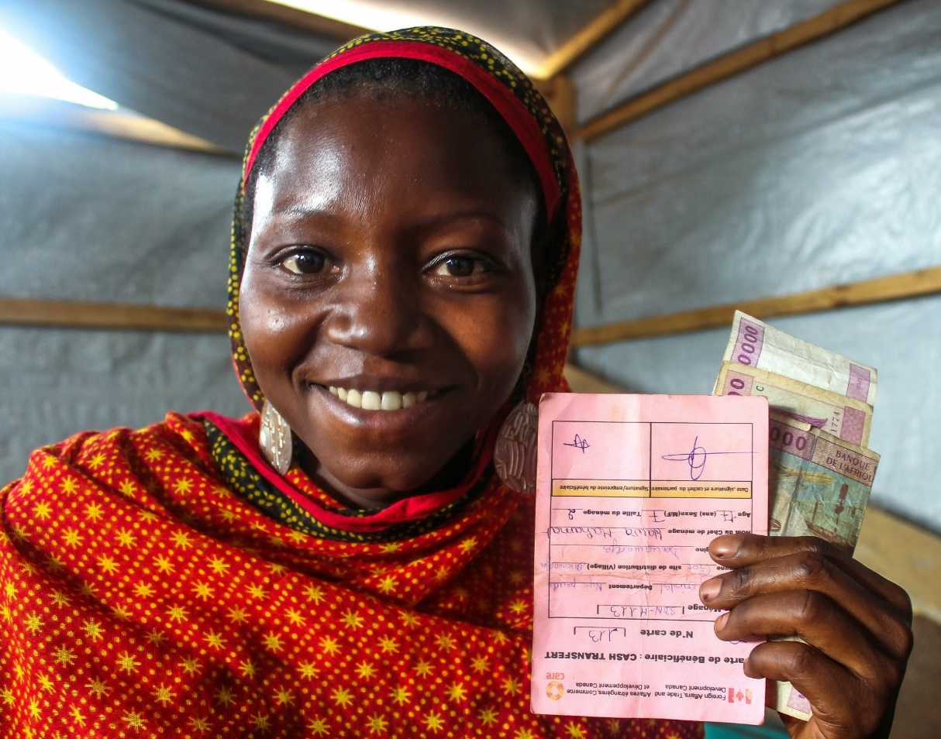
Image credit: CARE
Questions?

