Slide 1
Complaint & Response Mechanism Pilot
CARE South Syria & CARE Turkey
Nov 16’ – Feb ‘17

Slide 2
Pilot background
Why pilot?
Lack of evidence of solid partner accountability systems
Level of potential risk regarding unresolved complaints
Significant challenges in Syria regarding complaint handling
Lack of CARE direct contact with beneficiaries
Risk in handling of confidential complaint related information without adequate IM systems

Slide 3
Meeting Outputs
Program team are aware of development of Accountability standards and CRM Policy
Program team understand CRM pilot
Program team input into CRM pilot design
Agree CARE staff to cover key functions
To agree participation in CRM risk analysis
Agenda:
System overview
Pilot overview
System demo

Slide 4
System Scope
CRM system will encompass feedback and complaints related to CARE and partner programming. This includes:
      Programmatic complaints/feedback
      - eg. dissatisfaction with goods/services provided
      - eg. dissatisfaction with process (eg. selection criteria)
      - eg. general suggestions for future programming
      Code of conduct violations
      - eg. Allegations of fraud, corruption, SEA.

Slide 5
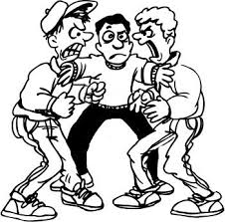
System Scope
      What is NOT handled by this system:
Complaints about organizations other than CARE or CARE’s partner organizations.
HR grievances of CARE staff, consultants and volunteers (for example disputes about salaries, benefits, workloads, supervision etc).
Vendor disputes (eg. disputes about contract terms and conditions).

Slide 6

System Scope
      Who can make a complaint through this system?
      Anyone! As long as it relates to a programmatic problem or code of conduct violation.
    Beneficiaries
    Non-beneficiaries
    Partner staff or volunteers
    Other NGOs
    Local authorities
    Community leaders
    Vendors
    CARE staff

Slide 7
Complaint Categorization
Out of scope
General feedback & suggestions (ideas or plans for future consideration
Request for information
Program complaint – No response
Program complaint – Individual response required
Program complain – Urgent
Breach of code of conduct or zero tolerance policy (including allegations of corruption, fraud, and sexual abuse and exploitation)
Complaints are also tagged according to the organization and sector they relate to, for efficient routing and processing of complaints.

Slide 8
Category | Examples
Category 1: Out of scope | Complaints about organizations other than CARE or CARE’s partners Vendor disputes about contract terms and conditions Staff HR grievances (eg. disputes about salaries, benefits, workloads, supervision etc).
Category 2: General suggestions (ideas for future consideration ) | Request to expand programming to a new geographic location Requests for a new type/sector of programming
Category 3: Request for information | Question about contents of a kit Question about eligibility criteria for a specific program Question about how to sign up for a sewing training

Slide 9
Category | Examples
Category 4: Programmatic complaint - no individual response required | Complaints which will be used to understand key trends and issues and feed into strategic decision-making, but where no individual response is possible/relevant at this stage, for example: Poor quality of items in a kit Long waiting times at a distribution General dissatisfaction with the quality of a training which is now finished.
Category 5: Programmatic complaint – individual response required | Minority group excluded from a program Items missing from a kit received Eligible household excluded (where distribution has finished, but future distributions may occur)

Slide 10
Category | Examples
Category 6: Programmatic complaint - urgent | Any issue that relates to a safety risk, affects a large number of people, is time sensitive or likely to cause major reputational damage, for example: Insecure distribution location [safety risk] Eligible household excluded from a list, where registration is currently ongoing [time sensitive] Dangerous faulty heater provided in winterization kits [safety risk, affects large number of people]
Category 7: Breach of code of conduct or zero tolerance policy (including allegations of corruption, fraud, and sexual abuse and exploitation) | Demand by staff member for payment to receive assistance Theft of items by a staff member Retaliation by staff member to a complaint Child abuse Sexual abuse or exploitation

Slide 11
Responding to complaints
Category | Standard responses
Category 1: Outside of scope | The complaint is acknowledged, and the person receiving the complaint explains why this is outside of what we are able to address through this system. Where possible, the complainant is referred to the relevant organization/focal point. No individual follow up required.
Category 2: General suggestions (ideas for future consideration) | The suggestion is recorded and the person thanked. The feedback is shared with the team (CARE and implementing partner) through the monthly digest, so that it can be considered as part of project reviews, lessons learned and new project design. No individual follow up required.
Category 3: Request for information | If the person taking the request knows or is able to immediately find the information requested, they provide the answer to the person at the time of taking the request. No individual follow up required. If the person receiving the request for information cannot immediately provide the information requested, the request will be forwarded to the SRD program team. Individual follow up required.
Notes:
Full SOPs for each complaint category. Summary only:

Slide 12
Responding to complaints
Category | Standard responses
Category 8: Breach of code of conduct or zero tolerance policy (including allegations of corruption, fraud, and SEA) | The complaint is reported immediately to the deputy director function, who will call a committee (which may comprise the Security Manager, the HR manager, the Country Director, and others as relevant - TBD). This committee will decide how to address the complaint, including if and how to investigate and if and how to respond. The response will be determined on a case by case basis, guided by CARE’s PSEA policy and HR manual. The complaint is not shared with partners, CARE program team or any other individuals unless authorized by the deputy director function.

Slide 13
CARE South Syria Pilot design
What?
Partner: One only
Scale: One distribution project
Agreed to keep the pilot as small as possible to maximize control.
Utilizing CARE monitoring consultants as part of CRM.
Focus on CARE CRM only. Partner channels not included in the pilot.

Slide 14
CARE South Syria Pilot design
How?
Phase 1:
  Phone line (whats app calls and messages) direct to CARE
  Face-to-face through MEAL consultants (ODK forms straight to database) – also handled by CARE
Phase 2
  TBD, based on community preferences and learning from pilot.
  These are intended to supplement channels that partners already have – NOT replace partner channels.

Slide 15
CARE TURKEY Pilot design
What?
Partner: SRD
Location: Marat Horma , Jarjanaz
Scale: One health facility
Agreed to keep the pilot as small as possible to maximize control.
Will pilot in one facility which has an average patient service and no major security issues to date.
Piloting CRM across CARE and Partner to focus on establishing a CARE channel, as well as supporting partner complaint handling.

Slide 16
CARE TURKEY Pilot design
How?
Phase 1:
Feedback boxes at facility level (paper based complaints forms at the facility via feedback boxes and a focal point (with complaints entered into a kobo form by SRD and sent to SRD Turkey)
What’s app number displayed at facility level (direct to CARE Turkey and entered into online system).
Phase 2
  TBD, based on community preferences and learning from pilot.
  These are intended to supplement channels that partners already have or support in refinement/improvement of existing partner channels.

Slide 17
CARE TURKEY Pilot design
Potential challenges:
Feedback boxes at facility level (paper based complaints forms at the facility via feedback boxes and a focal point (with complaints entered into a kobo form by SRD and sent to SRD Turkey)
    Managing paper based system (data entry)
    Frequent opening of boxes
What’s app number displayed at facility level (direct to CARE Turkey and entered into online system).
    Ensuring provision of full complainant information
Establishing dedicated channel for breach of CoC complaints
    Lack of CARE presence
    Need for sufficient level of resources for multiple channels
    Current lack of investigatory capacity (SRD & CARE)
Notes:
Response message in style of auto response in cases of missing info
Clear guidelines on information needed via comms materials

Slide 18
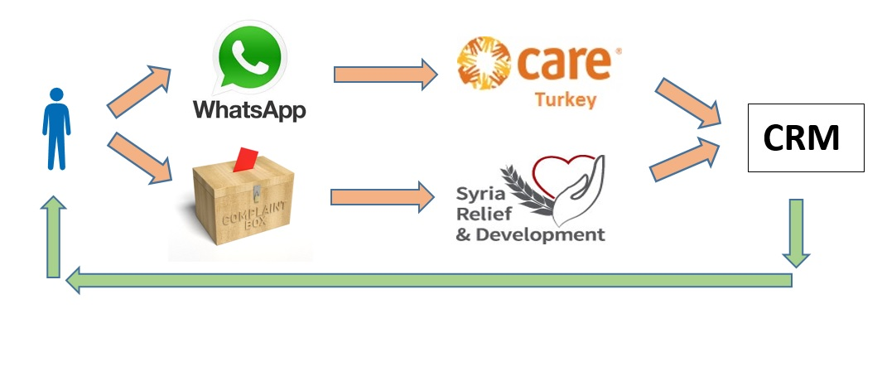
Complaint process flow

Slide 19
CARE TURKEY Pilot design
System management:
System functions defined in Istanbul MEAL workshop.
CARE Turkey Complaints Manager (CM) will create tickets for the complaints from the what’s app.
SRD CM will create tickets for those coming through the Kobo form.
Referrals are made within the system between CARE and SRD based on the complaint categorization.
CARE CM will be the overall manager of the system in terms of monitoring and follow up for Turkey based complaints.
Key function of Deputy Director (system language) to be appointed to lead on resolution of serious complaints.
Notes:
Add function slide

Slide 20
Key system functions
1 | Complaint Manager
 | Management & Operations | Manages day-to-day operation of system in compliance with policy, standards and procedures
2 | Complaint Registrar
 | Complaint Processing | Operates communication channels and administers processing of complaints and responses
3 | Technical Focal Point
 | Complaint Resolution | Handles resolution of complaints, using technical / sector knowledge
4 | Country Director
 | Commitment & Accountability | Demonstrates commitment and champions welcoming organizational culture and responsiveness
5 | Deputy Director
 | Operational Leadership | Leads development and compliant operation of system I Leads coordination and resolution of serious complaint handling

Slide 21
System Demo

Slide 22
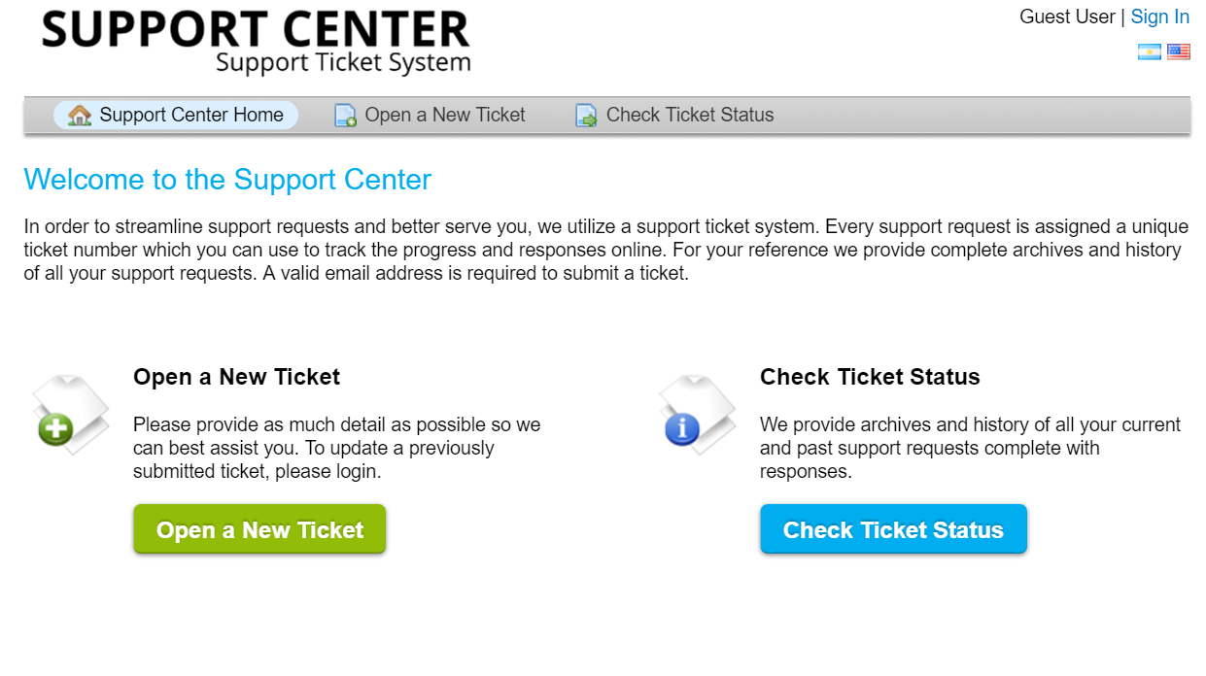
User Interface (Main Page)

Slide 23
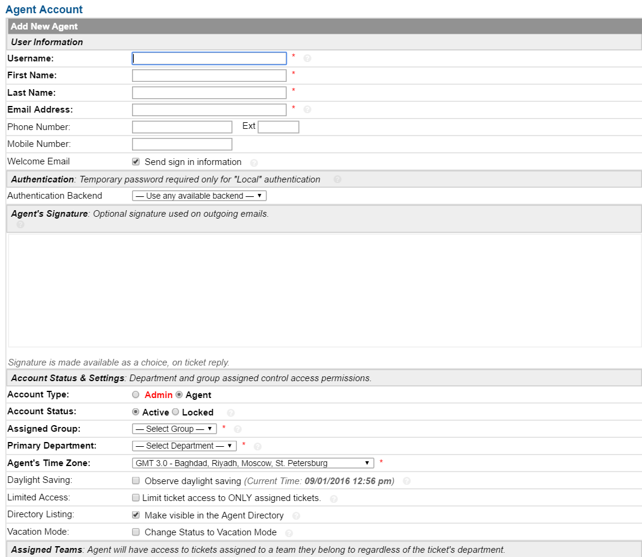
User Interface (Create Agent)

Slide 24
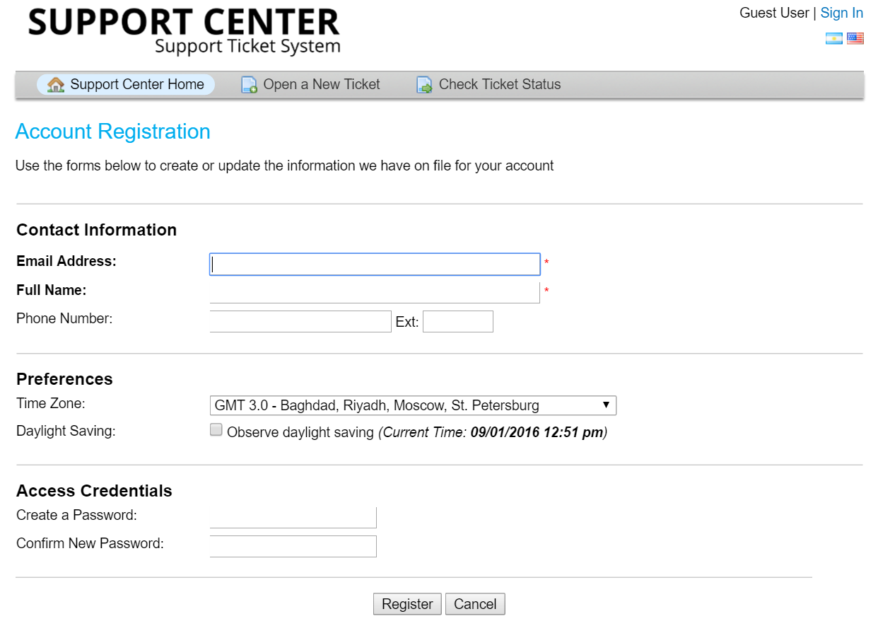
User Interface (Beneficiary – Account Registration)

Slide 25
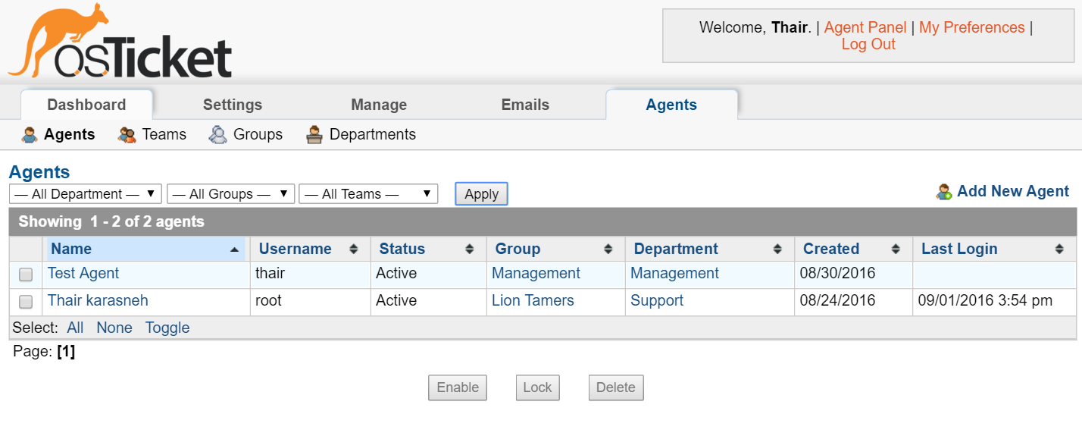
User Interface (Users List)

Slide 26
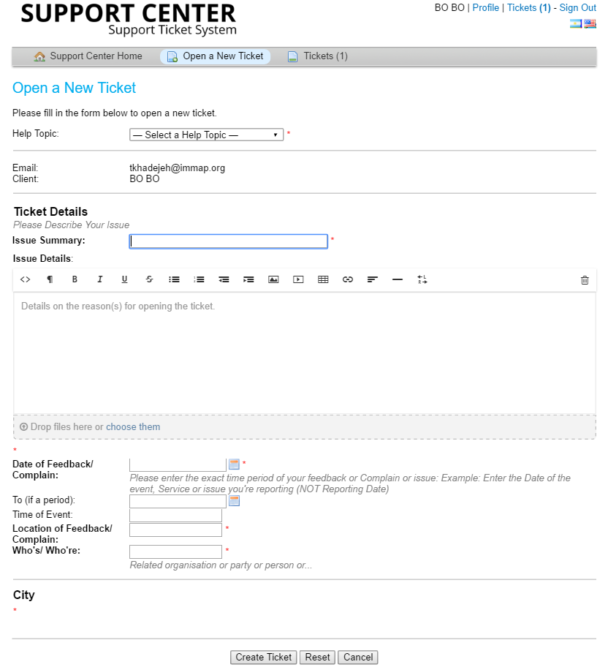
User Interface (Create New Ticket)

Slide 27
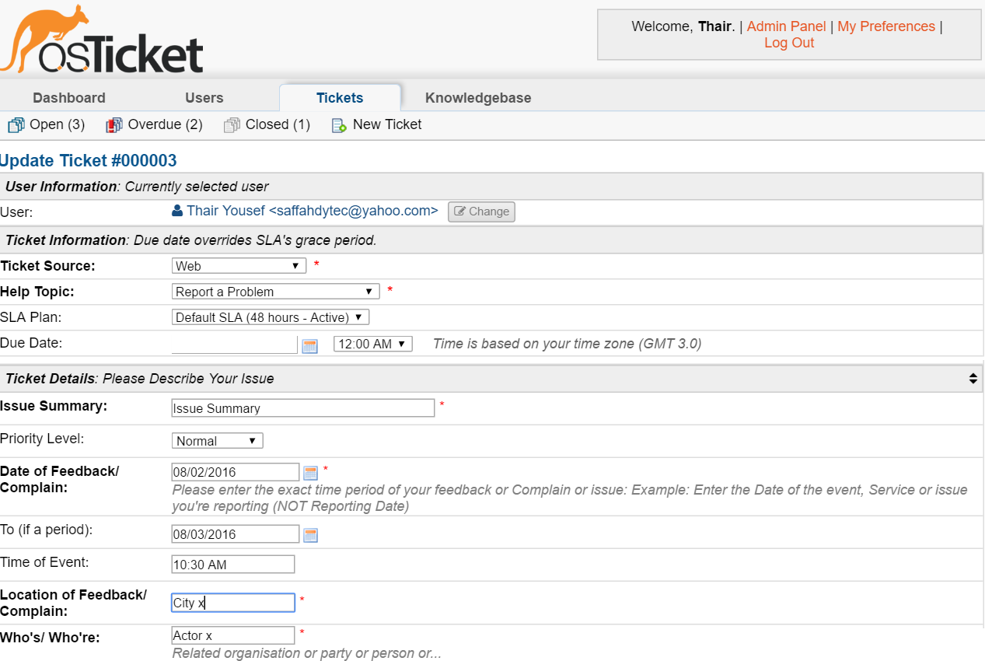
User Interface (Update/Follow-up Tickets)

Slide 28
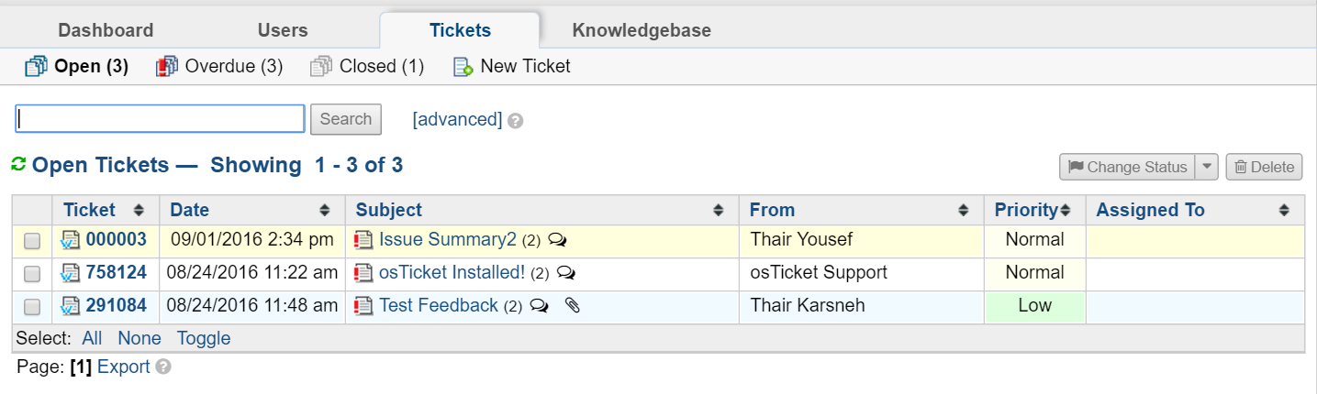
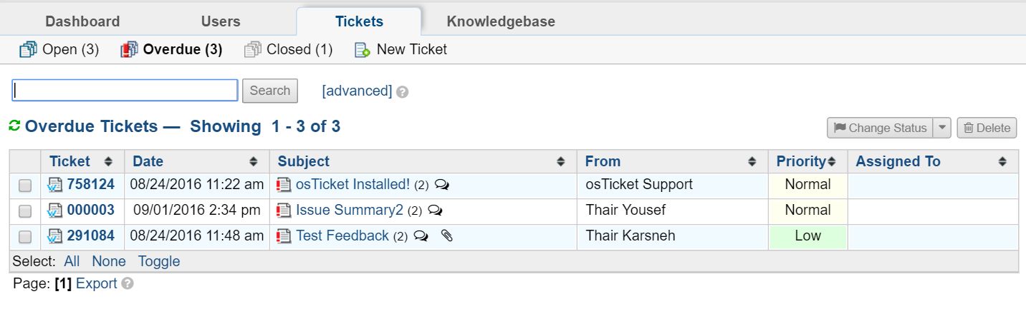
User Interface (Tickets Dashboards)
Open Tickets
Overdue Tickets

Slide 29
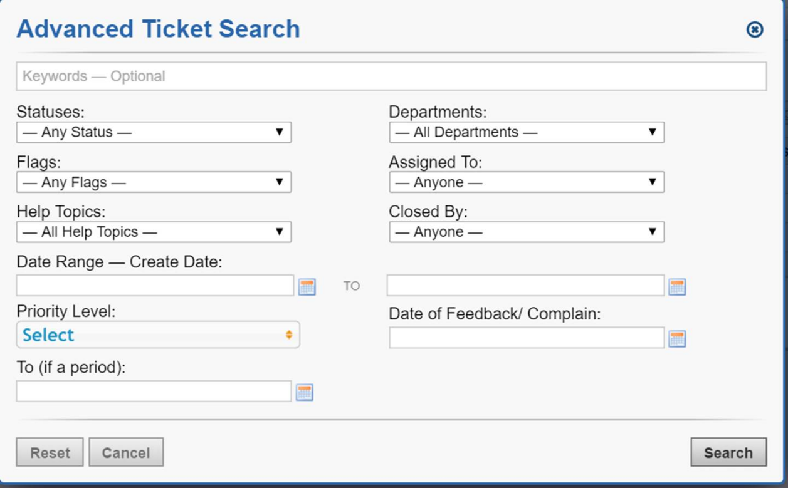
User Interface (Search)

Slide 30
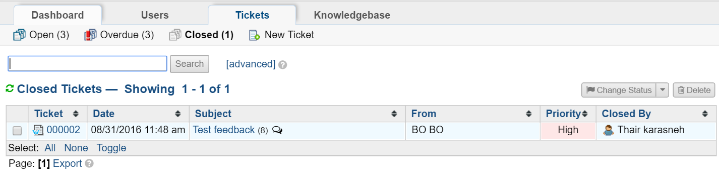
User Interface (Closed Ticket)

Slide 31
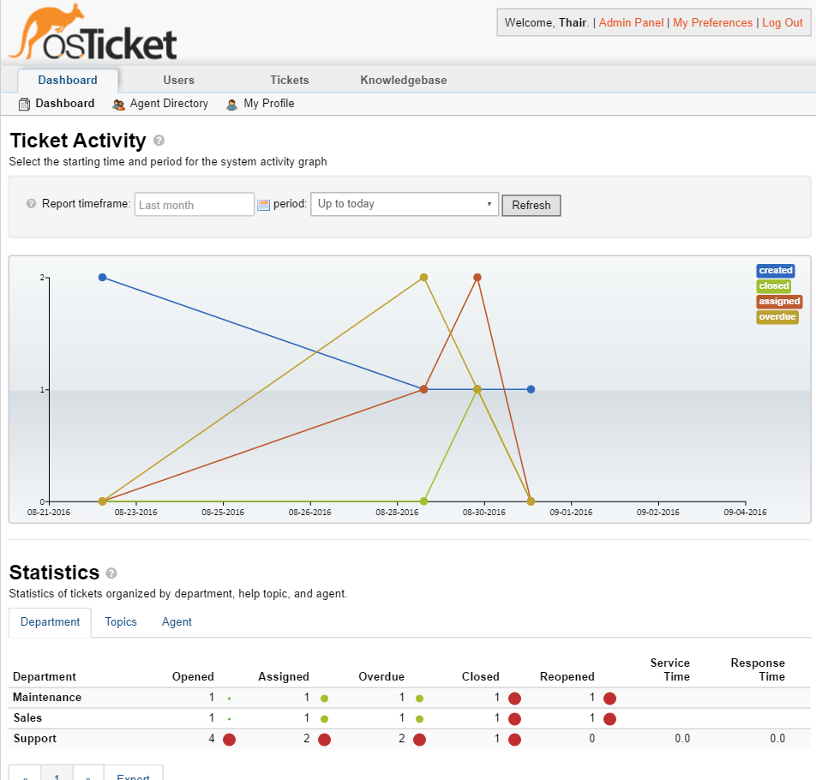
User Interface (Dashboard)

Slide 32
Overall Challenges
Technology at field level
Partner HR resource
CARE presence on the ground
CARE visibility re. external channel for beneficiaries
Enabling a dedicated channel for serious complaints
Handling PSEA complaints
Investigation capacity
Notes:
Risk analysis with SRD

Slide 33
Pilot Timeframes
CARE Turkey (November/December 2016)
CRM System testing and feedback
Development of information provision materials
Allocation of system functions within the CO
Risk analysis
Planning with SRD
CARE South Syria (November/December 2016)
Finalization of CRM system with IMMAP Jordan
Finalization of CRM manual
Partner meetings and planning
Pilot set for implementation mid December till end January with a review in February 2017.
In parallel:
Validation of draft CRM Policy
Baseline conducted with partners against MEAL standards

