Slide 1
CARE International
Gender in Emergencies

Slide 2


Commitments
Action
Notes:
There are MANY international, national and organisational commitments that promote gender equality and women’s inclusion during an humanitarian response. The Sex and Age Matters report by Tufts, OCHA and CARE shows that these commitments are not put into practice. Ask audience “How many humanitarian responses were informed by gender analysis?” Answer “Tufts in their 2011 Meta-analysis found NONE.” CARE is committed to putting these committments into humanitarian action.

Slide 3
Rapid Gender Analysis
Notes:
Rapid Gender Analysis is one way to put commitments into action. Define Rapid Gender Analysis. Can use audience participation to define it.

Slide 4
Principles of Rapid Gender Analysis
FAST
PROGRESSIVE
PRACTICAL
Notes:
These are three fundamental principles of RGA. Explain each one.
FAST: RGA needs to be available as soon as a crisis happens. Give example of great gender analysis being available a year later.
PROGRESSIVE: to be FAST RGA is built up progressively as information becomes available. This requires accepting IMPERFECTION.
PRACTICAL: reports should be conscise and recommendations need to be practical and meaningful to humanitarian practitioners

Slide 5
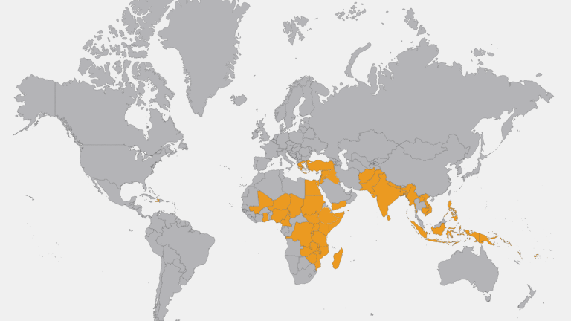
CARE Rapid Gender Analysis 2013- 2017
Notes:
CARE created Rapid Gender Analysis during the Syria response in 2013. It has since been used in 49 countries through preparedness or response

Slide 6
How does RGA work?

Slide 7
Five Step Process
Find
Collect
Analyse
Write
Share
Notes:
Five steps in a Rapid Gender Analysis. We will now go through each one.

Slide 8

Find available data that is disaggregated by sex and age, and existing analysis on gender relations.

Slide 9

2. Collect additional data by sex and age through gender assessments.

Slide 10

3. Analyse sex and age disaggregated data by comparing existing information with the results of the gender assessments.

Slide 11

4. Write practical recommendation for humanitarian action based on the analysis

Slide 12

5. Share Rapid Gender Analysis with other actors

Slide 13
When is it done?

Slide 14
RGA in Humanitarian Response Cycle
48 hours Share Gender in Brief
2 weeks Rapid Gender Analysis Report
6 weeks Rapid Gender Analysis Assessment Report
After Action Review Gender in Crisis
Preparedness Gender in Brief
Gender in Humanitarian Response
Notes:
This humanitarian response cycle refers to the OCHA phases of a rapid onset response.

Slide 15
What is available?

Slide 16
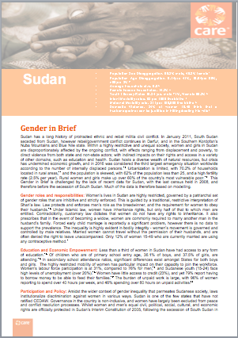
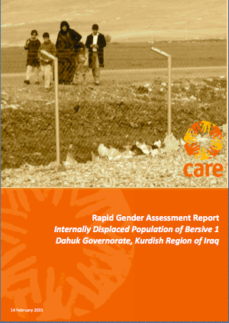
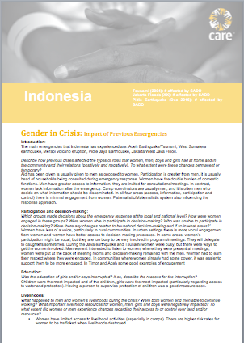
Notes:
From left to right:
Gender in Brief used in Sudan
Rapid Gender Analysis Report in Iraq
Gender in Crisis used in Indonesia

Slide 17







Find out more

