Slide 1
Rapid Accountability Review
CARE Response to Ethiopia El-Nino Drought 6/15 – 3/17
Uwe Korus
CARE Emergency Group
March 2017
Notes:
1

Slide 2
Basis for Rapid Accountability Review
CARE’s Humanitarian Accountability Framework (HAF) – especially:
CHS commitments 4, 5, 8
CARE Global indicators:
  GI 4: Scale & Scope of CARE’s quality & life saving humanitarian assistance
  GI 5: Satisfaction of affected people with relevance, timeliness and sufficient
  GI 19: meaningful participation of people in decisions that affect them in their recovery

Slide 3
Methodology of RAR
Focus Group Discussions (6 in 3 Woreda in Oromia)
Key informant interviews: LG (3 Woreda) & CARE staff
Document review:
  PDM reports
  Guidelines for targeting process, feedback and complaints mechanisms and PDM
  Other reports / reviews

Slide 4
RAR – FGD Methodology
Reflect on participants’ interactions and relations with CARE
Discuss key Principles of Accountability:
  Information Sharing
  Participation
  Feedback & Complaints
Scorecard

Slide 5
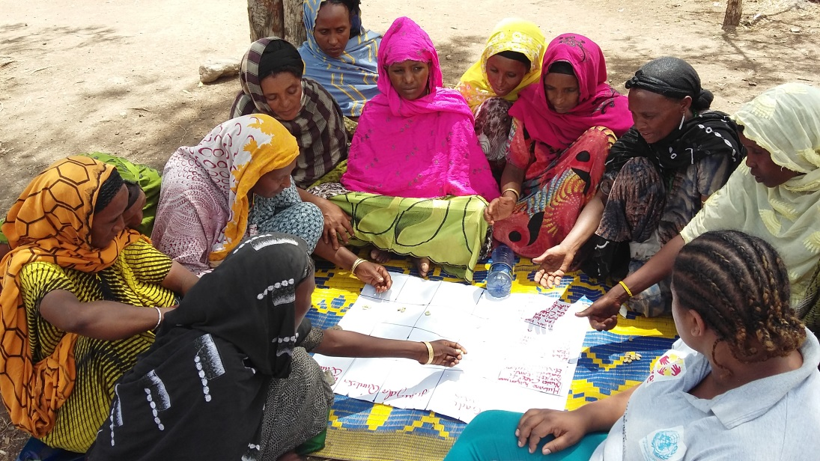
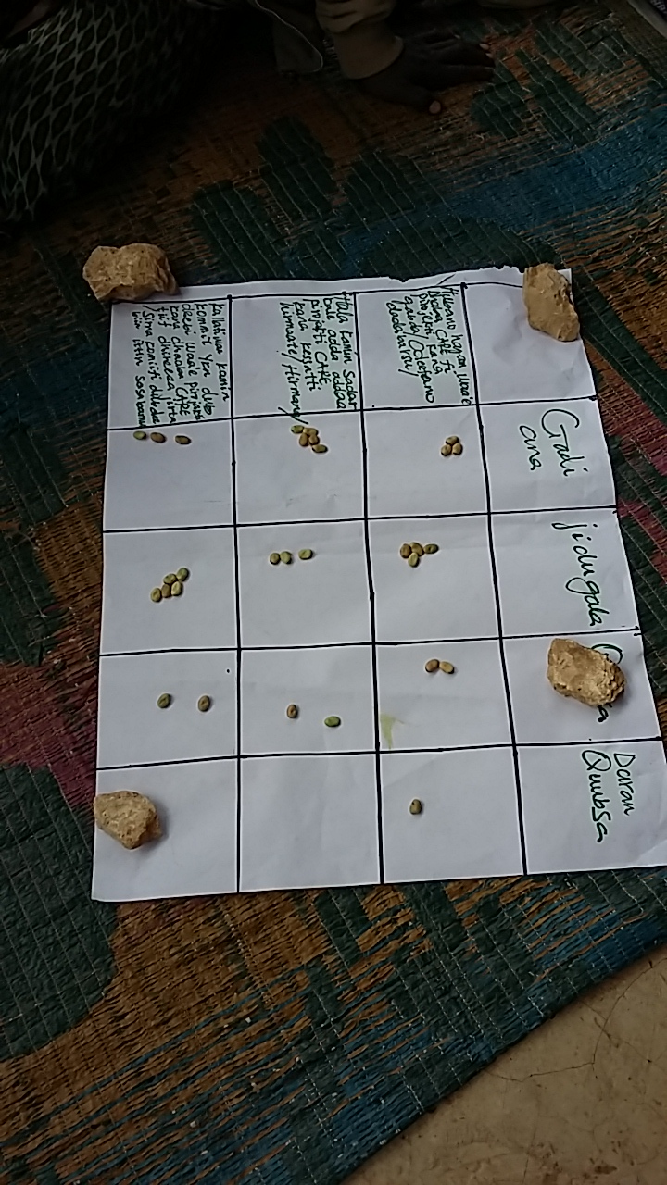
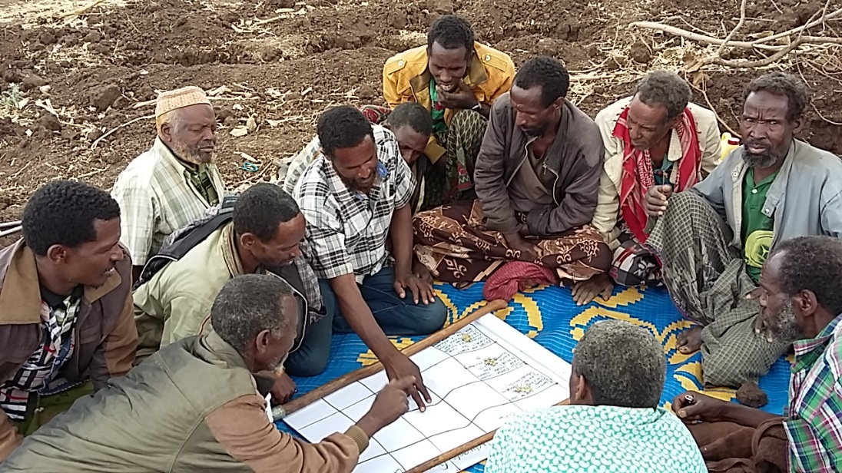
SCORECARD exercise during RAR

Slide 6




SCORCARD: scores and comments
Score | Many failures * 1 | Little failures * 2 | Strong * 3 | Excellent * 4 | AV [max=4]
Info-sharing | F: 0 M: 6 | F: 4 M: 6 | F: 17 M: 5 | F: 9 M: 13 | 3.2 2.8
Participation | F: 1 M: 5 | F: 4 M: 7 | F: 17 M: 10 | F: 8 M: 8 | 3.1 2.7
Feedback & complaints | F: 0 M: 3 | F: 13 M: 17 | F: 13 M: 5 | F: 4 M: 4 | 2.7 2.3
CARE's approach to decision making with LG and communities is recognized as collaborative, fair and inclusive.
Complaint committees are well established but have limited authority. No significant other feedback/complaint mechanisms.
Despite having limited authority CARE's presence in targeting process and ability to influence LG decisions instils trust.
CARE's value added most cited during the RAR: transparency (assessments, targeting), speed, consistency.
All stakeholders urge and expect CARE to stay engaged and to continue especially with recovery and DRR interventions as well as emergency assistance when needed.

Slide 7
FGD: some quotes
CARE is faster and more efficient than we can be at LG.
LG would be in danger and conflicts likely without CARE
Without CARE’s assistance we would have had to leave our village and the region as we did back in 1984.
CARE’s assistance ensured that MAM and SAM caseloads have significantly decreased
CARE ensures that women are involved in decision making despite resistance. Attitudes towards women’s empowerment have improved due CARE’s insistence .

Slide 8
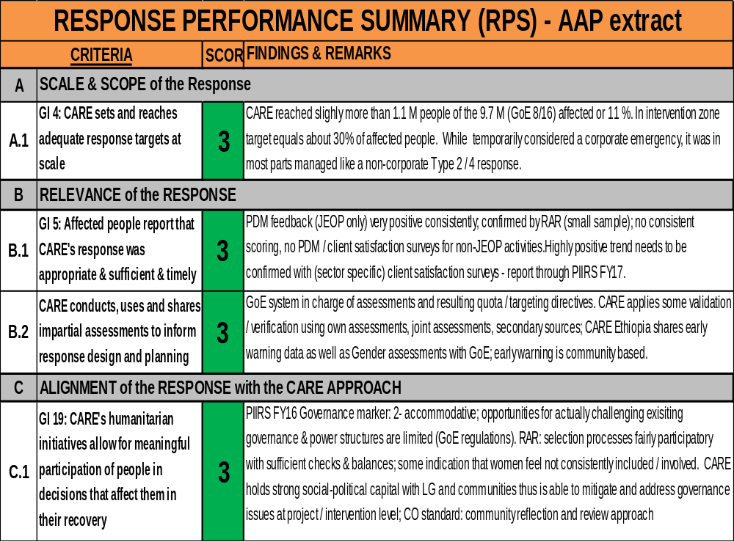

Slide 9
