Slide 1
SRHR in Emergencies & EPP
CARE has an SRHRiE Rapid Response Team member
Base slide deck
Notes:
Discussion with team – still quite long- what should be removed?
Should we introduce the demystifying MISP doc early on with the activities at different levels of care (and therefore perhaps removing the slides of diff levels at the end)
Do we need to put the MPAs further upfront; sufficient time should be spent discussing/ brainstorming slides 12 and 13
Should we include examples of EPPs; this could even be included in the CET

Slide 2
The cold hard facts
Women and children are disproportionally affected in humanitarian emergencies and are as much as 14 times more likely than men to die in a disaster
Of the 129 million people around the world in need of humanitarian assistance, approximately one-fourth are women and adolescent girls of reproductive age.
Of the preventable maternal deaths that occur globally, 60% occur in humanitarian emergencies
6 out of the 8 countries with high maternal mortality rates are conflict-affected
Sexual and gender-based violence is common in conflict settings and is often used as a weapon of war
Notes:
Conflicts create additional health burdens for women & girls
Women and children are disproportionally affected in humanitarian emergencies and are as much as 14 times more likely than men to die in a disaster
Of the 129 million people around the world in need of humanitarian assistance, approximately one-fourth are women and adolescent girls of reproductive age.
Of the preventable maternal deaths that occur globally, 60% occur in humanitarian emergencies and 6 out of the 8 countries with the 6 out of 8 countries with high maternal mortality rates are conflict-affected
Sexual and gender-based violence are common in conflict settings and requires a robust response
Women and girls everywhere have the right to SRH, which is a human right
SRH is important to our humanitarian vision
SRH is essential in order to being a tier 1 humanitarian responder

Slide 3
The need for a robust SRH response
needs
access
Preventable illness & death
Notes:
Sexual and reproductive health needs do not go away during humanitarian emergencies
In fact, they often increase:
Gender based violence including rape may increase in the chaos of an emergency.
This can lead to unwanted pregnancy, unsafe abortion and HIV/STI infection
Women and their partners may choose to avoid pregnancy until the situation returns to normal
Stress may cause pregnant women to go into labor pre-maturely
Women and girls experience complications during pregnancy and delivery
However, while needs increase, people’s access to these services may actually decrease due damaged infrastructure, equipment & supplies, roads and transportation.
As a result, some women and newborns may die from preventable pregnancy-related complications, such as hemorrhage and infection. This risk is among the highest for adolescents.

Slide 4
CARE SRHRiE’s programming along the humanitarian program cycle
Emergency preparedness and planning
Emergency response in line with the Minimum Initial Service Package for SRH in Crisis-Settings
Recovery and Health systems-strengthening in protracted setting
<------------- Gender in Emergencies & Localization -----------→
<---------Adolescent SRH programming-------------→
<-----Community-based disease surveillance--→
<------Advocacy and Accountability---→
Thought Leadership
Notes:
: CARE works with local government, communities and humanitarian actors to prepare for potential future emergencies through contingency planning, building the capacity of responders, prepositioning commodities, earmarking funds, and putting in place the institutional arrangements needed to meet the SRH needs of crisis-affected populations.
CARE works to ensure that Minimum Initial Service Package (MISP) for Reproductive Health in Crisis Situations is implemented at the outset of a humanitarian response. The MISP was developed by the Inter-agency Working Group (IAWG) on Reproductive Health in Crises to address women’s most immediate SRH needs in crises. As soon as the MISP is in place, CARE works to establish comprehensive SRH service delivery.
CARE works in post-conflict and fragile settings to strengthen local health systems to deliver high-quality SRH services, with a focus on family planning (long-term methods) and post-abortion care. CARE’s approach has three components: 1) competency-based training with follow-up clinical assessment and coaching, 2) support for program quality including regular supervision of health facilities and providers, regular use of routine data to inform decision-making at all levels, and putting in place a supply chain for SRH commodities with a focus on the last mile and 3) mobilizing communities to raise awareness about family planning and to shift gender and social norms that block women’s access to family planning services.

Slide 5
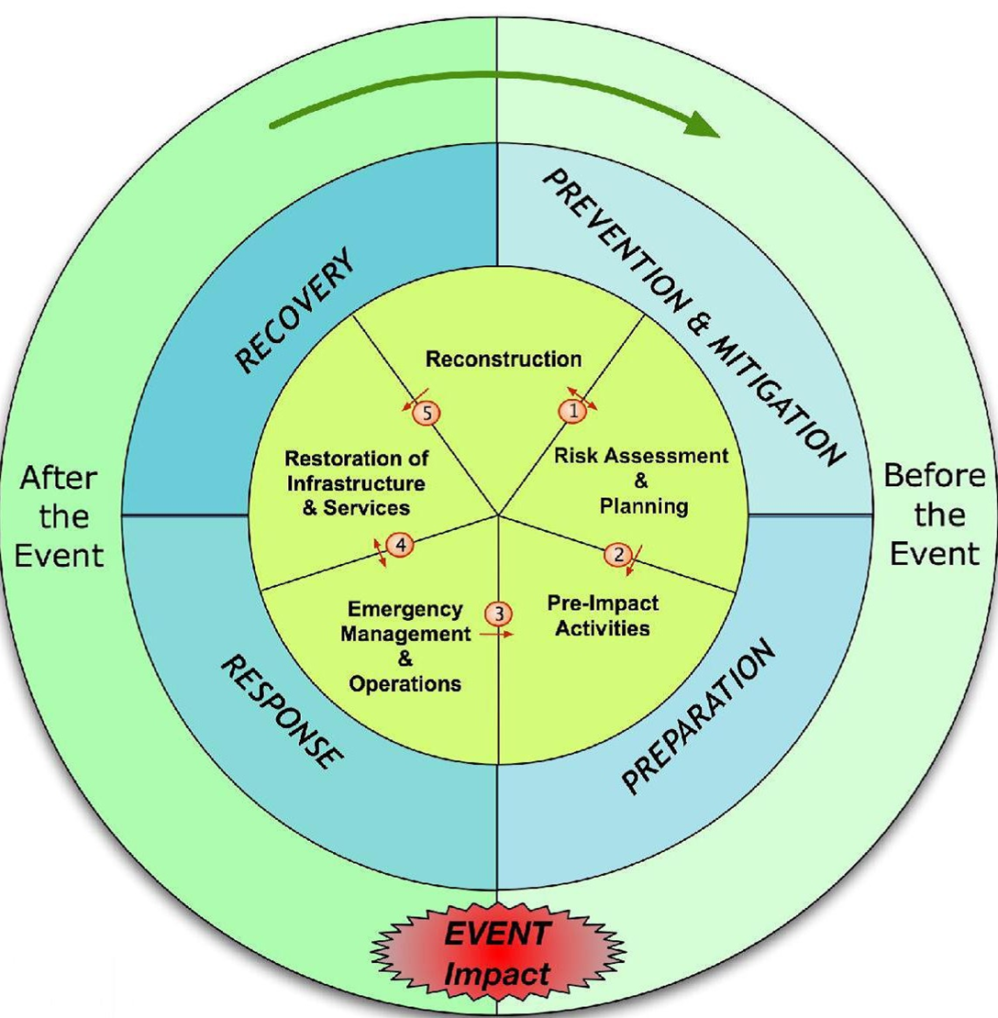
Comp SRH
SRH in DRR,risk analysis
SRH in EPP, pre-position
training
MISP
Notes:
Prevention and Mitigation: Prevention: Actions take PRIOR to crisis to decrease the likelihood that an crisis will occur. Mitigation: are the actions taken to reduce the impact of lives lost or damage done related to the crisis that can’t be prevented.
Preparation: look at different emergency scenarios and develop feasible and appropriate response.
EMERGENCY: an event or incident that threatens public safety, health, welfare.
3. Response consisting of immediate deployments and possibly longer term technical support
4. Recovery: During recovery, populations are more stable and able to resume a more normal and regular existence (school, markets, religious and cultural activities resume).
So with that introduction of the HPC, lets break into small groups and discuss :
What phase is your country in?
What SRMH activities and programs are is your country office involved in these different phases?

Slide 6
What is the MISP?
The Minimum Initial Service Package for Reproductive Health in Crisis Settings is:
A set of priority SRH activities to be implemented at the onset of a humanitarian crisis
  Ideally implementation should take place within 48 hours
  Planning and preparedness is critical
Can be implemented without an in-depth SRH needs assessment
  The identified SRH interventions are life-saving
A minimum set of activities
  Humanitarian stakeholders should transition to comprehensive SRH services as soon as possible (and certainly within 3 months)
Notes:
The Minimum Initial Service Package for Reproductive Health in Crisis Settings is:
* A set of priority SRH activities to be implemented at the onset of a humanitarian crisis
Ideally implementation should take place within 48 hours
Planning and preparedness is critical
Can be implemented without an in-depth SRH needs assessment
The identified SRH interventions are life-saving
A minimum set of activities
Humanitarian stakeholders should transition to comprehensive SRH services as soon as possible (and certainly within 3 months)

Slide 7
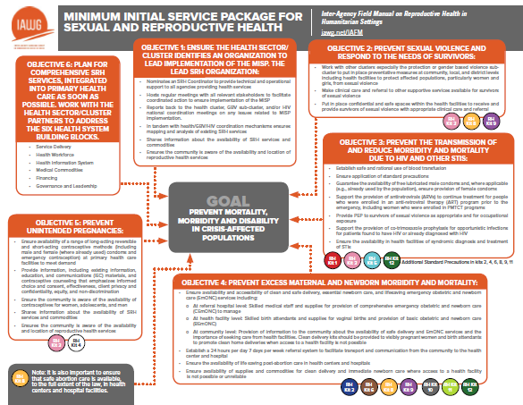
MISP 2019 objectives

Slide 8
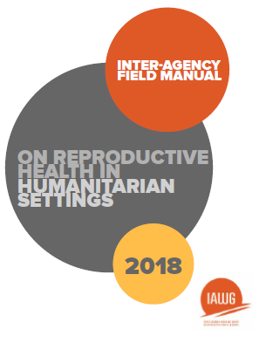
What is the IAFM?
The Inter-Agency Field Manual for Reproductive Health in Crisis Settings:
Serves as the authoritative source for SRH programming in humanitarian settings
Based on guidelines issues by normative bodies, particularly the the World Health Organization (WHO)
Provides SRH Coordinators, program managers health service providers, and other field-level practitioners with technical and programmatic guidance
Serves as a tool for coordination, fundraising, and advocacy
Notes:
The Inter-Agency Field Manual for Reproductive Health in Crisis Settings
Serves as the authoritative source for SRH programming in humanitarian settings
Based on guidelines issues by normative bodies, particularly the the World Health Organization (WHO)
Provides SRH Coordinators, program managers health service providers, and other field-level practitioners with technical and programmatic guidance
Serves as a tool for coordination, fundraising, and advocacy
The IAFM was first produced by the IAWG in 1999 with several revisions, the most recent being in 2018
The IAFM outlines a set of minimum reproductive health interventions, known as the MISP, to be put in place at the outset of a humanitarian crisis
The Inter-agency Working Group on Reproductive Health in Crises (IAWG) is a broad-based, highly collaborative coalition that works to expand and strengthen access to quality sexual and reproductive health services for people affected by conflict and natural disaster. IAWG works to:
Document gaps, accomplishments, and lessons learned
Evaluate the state of sexual and reproductive health in the field
Establish technical standards for the delivery of reproductive health services
Build and disseminate evidence to policy makers, managers, and practitioners
Advocate for the inclusion of crisis-affected persons in global development and humanitarian agendas

Slide 9
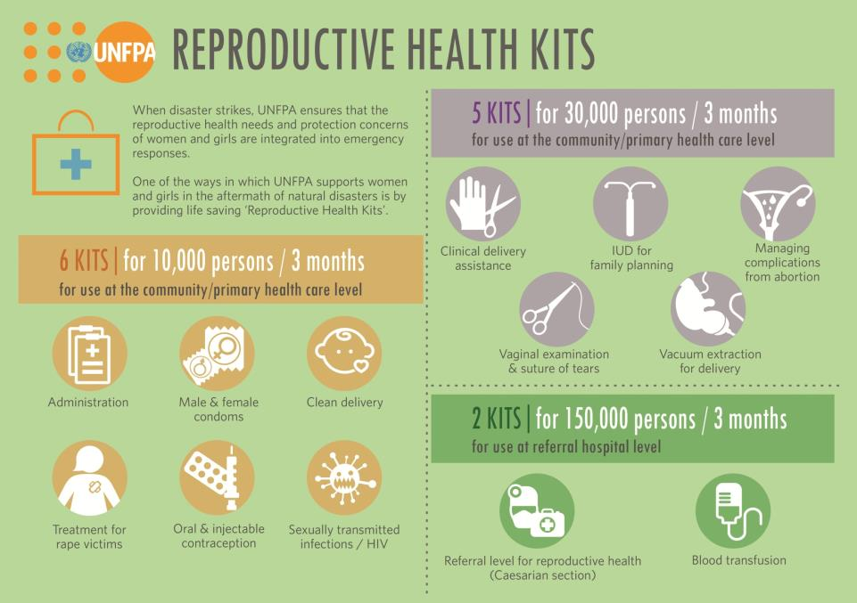

Slide 10
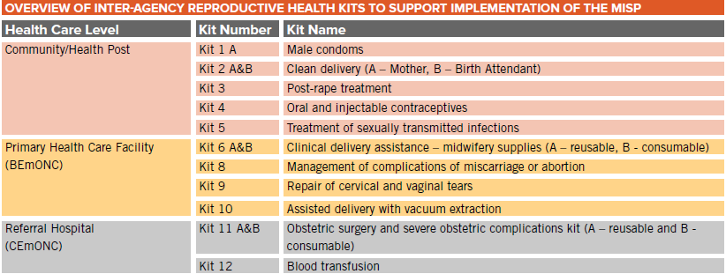
Inter-agency Emergency Reproductive Health (IERH) Kits
Notes:
The first ‘right’ involves products, goods or commodities.
Inter-agency Emergency Reproductive Health (IERH) Kits are one possible source of SRH goods for humanitarian response.
This slide presents an overview of each type of IERH kit.
Before ordering kits, SRH agencies should determine whether it is possible to obtain SRH supplies locally to meet the SRH needs of affected populations. For example, agencies may be able to obtain IERH kits from UNFPA in-country.
If kits or supplies are not available in country, that agencies can procure IARH kits from UNFPA’s Procurement Services Branch in Copenhagen.
Agencies and program managers should coordinate with clusters and other agencies to ensure SRH supplies are part of the health cluster/ sector core commodity pipeline.
It should be noted that not every context will require procurement of IERH Kits, or all of the available kits.

Slide 11
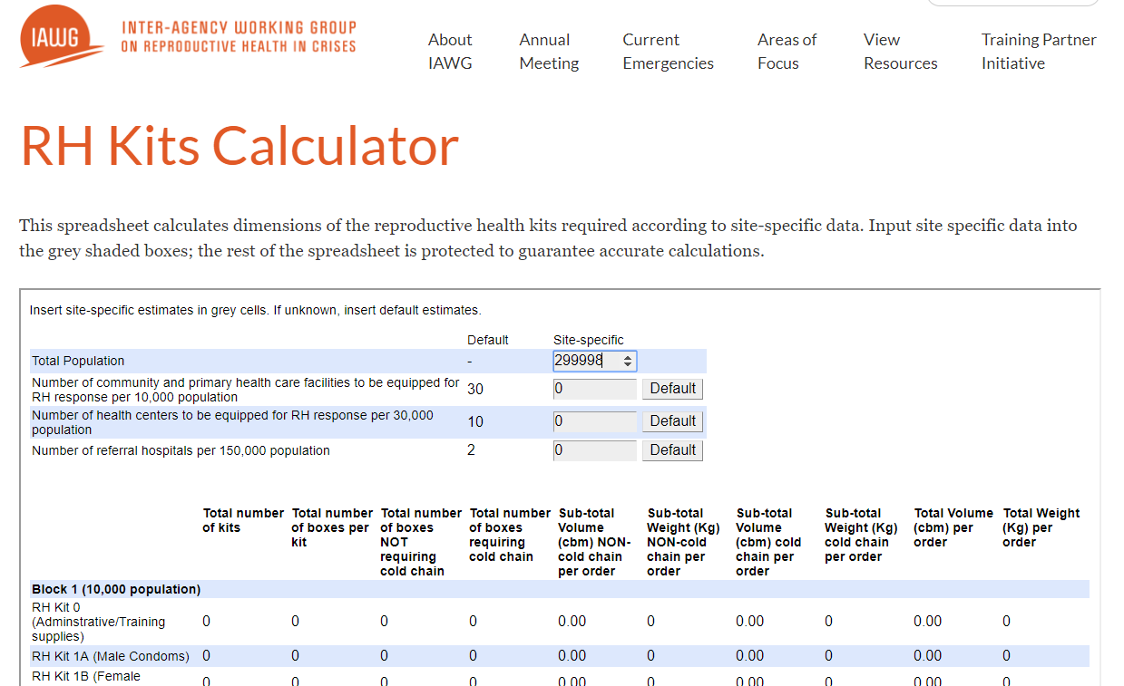
RH Kit Calculator
http://iawg.net/resource/rh-kits-calculator/

Slide 12
SRH in EPP
Risk Analysis
SRH-E Response Options (MISP & Modalities)
Personnel
Logistics & Pre-positioning
Internal Capacity: Current SRH/PHC existing programs and program strategies
Inter-Sector Collaboration
SRH Policy & Protocols
Capacity of Host Country MoH & National Disaster Management Team
Assessment of external partners: strategic, partner NGOs, community
Mapping of facilities
Next steps for planning & preparedness
Notes:
@ end ask- what are some minimum action you think you’ll take
Includes the emergency scenarios from CO EPP and identifies vulnerable populations
Identifies CARE personnel needed for SRH response; opportunities for CARE inter-sectoral collaboration
Identifies SRH materials and supplies needed
Identifies external CARE strategic and local partnerships to collaborate with to support SRH response; UNFPA country/regional representative
---SRH-E Options; in collaboration with (Working through local partners/NGOs/community-based organizations; Ministry of Health and/or Ministry of Disaster Management; international partners such as UNFPA, WHO, MSI, IRC, IMC, Save the Children, etc).
--Personnel : staff availability, capcities, roles and capacities
(Coordination within CARE office
Attendance of health cluster meetings and SRH working groups
Coordinate with external partners
Locate and mobilize RH kits and clean delivery kits either within the country or in the pre-positioned locations)
--Logistics/ RH Kits – MOUs putting them on our AVL & Pre-positioning (# of items, procurement plan, warehouse capacity)
-rovide examples of appropriate program strategies that can be used to build off of current programs that will support SRHE program strategies (i.e. community mobilization, health system strengthening, clinical training, social analysis and action, women’s empowerment, participatory governance, etc.).
-Inter-Sector Collaboration: CO Needs, capacity, action
-Policies & protocols

Slide 13
Minimum Preparedness Actions for SRHRiE
Ensure Regular contact between CO and Emergency SRHRiE Global Team/Sector lead (at least annual)
Collaborate with UNFPA through participation in SRH sub-working group (or health cluster) and efforts to operationalize global MOU
Identify an SRHR focal point on CARE ERT
Ensure suppliers/vendors of SRH items are on the approved vendor list
Capacity building of team on MISP and CARE SRHRiE Minimum Commitments to gender and diversity
Map out referral pathways, health facilities and human resource capacities
Ensure SRHR in standard rapid assessment tools

Slide 14








Recovery & Nexus Approach: Example SAFPAC Initiative
SAFPAC MODEL
Competency-based training for healthcare providers
Readiness for emergency response
Strengthen the supply chain system
Women and girls exercise their rights and have access to high quality of family planning services and post-abortion care MISP services in crisis affected settings
Assess and address negative attitudes
Data for decision making
Policy and Advocacy
Institutionalize and scale up
Assess and address social and gender norms. (Community engagement/SAA)
On-the-job coaching
Supportive Supervision
Document, learn and share.
Notes:
NEXUS IN STRATEGY
SAFPAC aims to build CARE’s organizational leadership and capacity to support provision of family planning (FP), post-abortion care (PAC) and reproductive health services in emergencies, all while improving access to and quality of FP and PAC services in emergency-affected settings.
Program Information:
$23 million dollar grant by a large, anonymous donor. It is currently in its third phase, with a fourth phase anticipated beginning in 2019.
Currently operating in 4 main countries and anticipating adding one or two additional countries, preferably with high need for SRHE in humanitarian crisis.
Seeks to increase access to family planning and reproductive health services in post-crisis and crisis settings through country level programming, technical assistance, and limited humanitarian funding for responding to acute emergencies.
Program focus includes FP and PAC as well as other MISP components, including EmOC, HIV prevention and referral, GBV, and GiE.
Example of sapacity building long term and also acute
CARE has been implementing SAFPAC in North Kivu province of DRC (HSS and emergency preparedness on SRHR)
Since August 2016, some 1.3 million people in the neighboring Kasais were displaced within the DRC by the violence that has grown out of a locally rooted conflict. The consequences of this crisis for girls and women have been dramatic.
The existing capacity in neighboring North Kivu, enabled a locally-led response by CARE including:
implemented the MISP in 5 health zones in Kasai Oriental with funding from SAFPAC and UNFPA
Through CARE’s appeals fund, in July 2017, CARE launched an SGBV response in 3 HZ in Kasai Oriental.
In September 2017, the SAFPAC initiative began SRH programming (including FP) in the crisis-affected areas in Kasai Oriental. All methods are available – short acting methods, and LARC methods (including permanent methods as needed).
CARE added value to the overall humanitarian response by providing access to FP in three health zones in Kasai Oriental. The affected areas of Kasai Oriental were initially facing a major health challenge in terms of unmet need for FP, a situation that contributed to the increase in the number of unwanted pregnancies and abortion-related complications in the context of humanitarian crisis.
If notes needed on why nexus
In line with Norway strategy, CARE recognizes:
Two-thirds of humanitarian assistance is provided to long-term recipients of a duration of eight (8) years or more.
Currently, 80% of the global humanitarian needs emanate from violent, man-made conflict.
Long-term fragility in the MENA region and beyond: Witnessing harmful impact of continuing aid; dependency; lack of trust; etc..
Successes and failures from the ground! Examples from CARE WBG, CARE Jordan, CARE Syria

Slide 15




SRHRiE Minimum Commitments for Gender and Inclusion

Slide 16

Sexual and Reproductive Health and Rights
Minimum Commitments for Adequate and Inclusive Services
ASSESSMENT
DESIGN
Analyze how power dynamics affect adolescent girls’ and women’s access to services
to inform the targeting and the design of your support
Develop your programmes for and with adolescent girls and boys, women and men, including those most marginalized
IMPLEMENTATION
Provide quality services to all, overcoming the barriers that pregnant and breastfeeding adolescent girls and those most stigmatized face
ACROSS THE RESPONSE
Engage men and boys to champion the use of family planning methods and to promote respectful and nonviolent relationships
5 commitments
RESPONSE MONITORING
Monitor equitable access to services and set confidential and responsive feedback & complaint mechanisms
Notes:
2-What is the minimum commitments tool?
These 5 commitments you see here in the pink boxes are the first part of the tool.
Commitments cover core actions or approaches which sector members should systematically apply in their operational response at each phase of the project cycle.
These commitments reflect key priority issues in the SRHR sector.
They were developed using 3 types of analysis:
1. The needs or barriers certain groups may face based on gender, age or diversity. The groups that have been prioritized are:
-Adolescent girls and boys
-Pregnant and lactating adolescent girls
-Sexual minorities
- Persons with a mental or physical disability
2. On an understanding of gender dynamics that may lead to vulnerabilities. For SRHR, we are mainly focusing on men – they are husbands, fathers, partners, and decision-makers, especially related to decisions on contraceptive use.
3. An analysis of existing challenges to the quality and appropriateness of SRH assistance provided – or what SRHR teams don’t do well
As you can see in the commitments, the analysis has found that we can do better analysing and responding to power dynamics within the home and within the community, tailoring interventions to the unique and multiple needs of adolescent girls and boys and other hard-to-reach groups, and Monitoring equitable access to SRH services needs
It is based on the combination of these 3 elements that the MCs were drafted. We do not want to re-state again what is already known (e.g. in SRH, focus on women of reproductive age) but about calling the attention on important issues that may be overlooked
Let’s start with the Commitment during assessment phase of programs…. We commit to analyse…

Slide 17
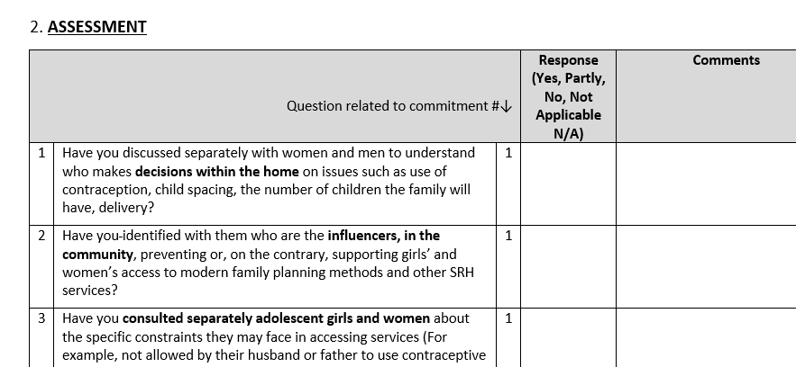
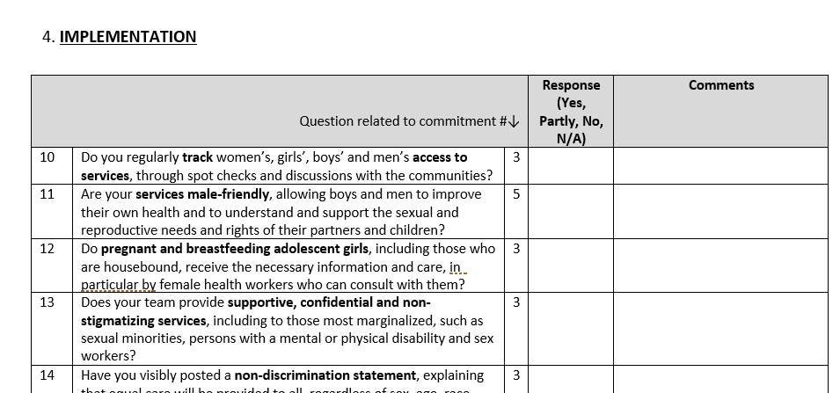
Open up your Self-Assessment Questionnaire
What do you see?
Notes:
If everyone could open up their Self-Assessment Questionnaire document, we will go through the assessment format together
Scroll down to page 2 – this is where the assessment begins
Assessment phase is the first place you will see questions to ask yourself and/or your team about your program.
Go ahead and read some of those questions. After you’re done, type in the chat box how long you think it will take you and your team to answer these questions in just this Assessment section.
What is the next section you see?
Ok, let’s move to Section 4 – Implementation. You can see there are only 5 questions – so remember, this assessment is not meant to cover all of your programs and all of your interventions in a program. We want to keep it short, simple, practical, and relevant to gaps or challenges many programs face.

Slide 18
Minimum Commitments: Using the Assessment as a MONITORING TOOL
Analyse the performance of individual SRHR programs in your Country Office
Scoring your Assessment:
NAME OF COUNTRY OFFICE | Assessment | Design | Implementation | Response monitoring
SAFPAC
SRHR Program B | N/A
SRHR Program C
SRHR Program D |  |  | N/A
SRHR Program E
SRHR Program F
All the answers to the questions are “YES” | GREEN
More than half of the answers to the questions are “YES” | ORANGE
Half or less of the answers to the question are “YES” | RED
Notes:
Along with the 5 commitments and the self-assessment questionnaire, a traffic light system has been set up to monitor programs.
Open up the document 3 – Monitoring Form, and scroll down to page 3.
The idea is not to evaluate or rank the quality of the programmes, but to monitor compliance and how programs use a gender, age and diversity lens, taking corrective actions where necessary
The monitoring form is used to:
Analyze individual projects, such as GSK, to see if any program requires support or
Analyze multiple projects to see which phase of the programme cycle requires particular attention
To use this system, you can review your answers to the assessment:
If you answered ‘yes’ to all the questions in a section, then that sections gets a green box
If you answered ‘yes’ to more than half of the questions in a section, then that section gets an orange box
If you answered ‘yes’ to less than half of the questions in a section, then that sections gets a red box
Let’s look at the GSK program as an example here. We can see that all the questions in the Assessment and Design sections of the self-assessment were answered ‘Yes’, however, Implementation received an orange box. That means that in the Implementation section, half or more of questions were answered ‘yes’. Response monitoring is the only section to be red, so that means less than half of the questions were anwered ‘yes’. The red and the orange boxes tell us which part of our response need to be reviewed and adjusted to make SRH services adequate and inclusive.
So you can do this for every program in your SRHR portfolio. If you have multiple, then you can compare programs against each other. For the pilot, we will be focusing on just one program, which is SAFPAC.

Slide 19







SRH Integration Across Sectors to meet the holistic needs of women and girls
WATER AND SANITATION HYGIENE
Menstrual hygiene management
Dignity kit distribution
Infection prevention & control
FOOD SECURITY
Preventing anemia to reduce the risk for maternal hemorrhage
Ensuring nutrition during pregnancy, the postpartum period, and beyond
SRH
GENDER EQUITY
Clinical SRH services for GBV survivors
Preventing adolescent GBV and pregnancy through education, access to family planning, and reducing childhood marriage
EDUCATION
Comprehensive sexual education
Reducing unplanned pregnancies so girls can stay in school
HUMANITARIAN RESPONSE
-integrated response across sectors
- Age-sensitive & gender transformation
Notes:
SRH is central to meeting needs of women and girls. in nigeria, we have the capacity and need to strengthen agility for responding to needs in acute crises + integration across sectors is critical to maximizing potential
SRH is easily integrated into almost all sectors. These are just a few ideas—in reality, there are many other ways to integrate SRH programming into other projects.
There are three types of ways other sectors can engage SRH : through community-based activities, basic clinical service provision, and expanded clinical service provision.
Pregnant and lactating women should receive an appropriate fortified food supplement:
500 to 700 kcal for onsite feeding; and
1000 to 1200 kcal as a take-home ration
Pregnant and lactating women must receive daily supplements of iron and folic acid and lactating women should receive Vitamin A
Promote exclusive breastfeeding for the first six months and continued breastfeeding for up to 2 years and beyond

Slide 20
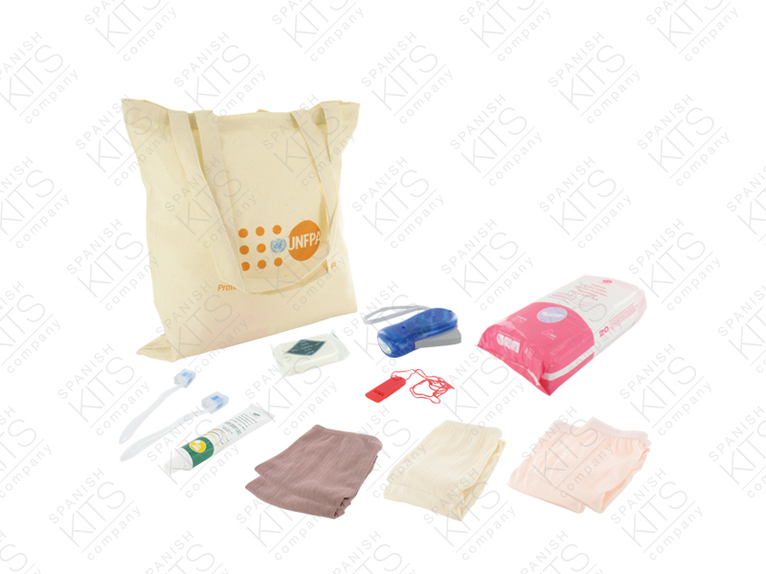
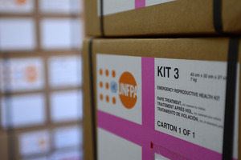
Level 1: Community-Based Activities
Community-based SRH education and supplies distribution
Activities might include:
  Handing out clean delivery kits along with dignity kits
  Disease prevention and awareness-raising for SRH by community health workers
  Examples of opportunities for integration with other sectors include:
    Talking about menstrual hygiene management during WASH programming
    Awareness raising on SRH including maternal health topics during FNS programs (ex: link between anemia and hemorrhage in pregnant women)
    Discussing availability of GBV clinical support services during gender programming or other awareness activities

Slide 21
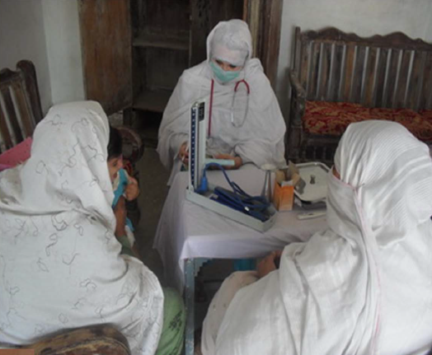
Level 2: Basic Clinical Service Provision
Some SRH service provision: mobile clinics, PHCs
Examples of integrated activities might include:
  Offering family planning alongside other services at mobile clinics
  Midwives refer pregnant women and adolescent girls to nutrition counselors
  Women & Girls Safe Spaces offer SRH services

Slide 22
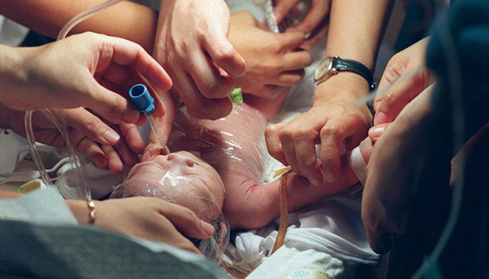
Level 3: Expanded Clinical Service Provision
Advanced clinical SRH service provision
Activities might include:
  Working with existing clinics (or establishing new ones, if needed) to expand Emergency Obstetrics and Newborn Care (EMoNC) delivery
Notes:
Consider service delivery partners

Slide 23
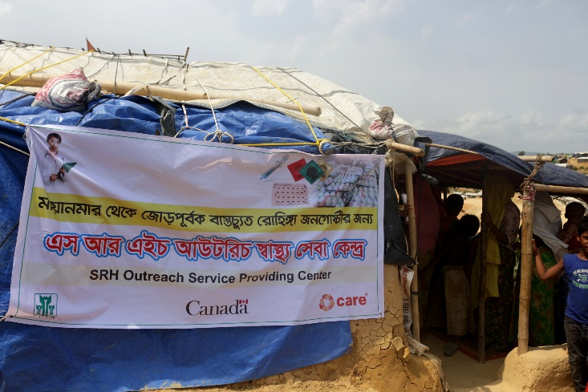
Cox’s Bazaar SRHRiE example
CARE Bangladesh’s SRHE activities is going on Camp # 12, 13 & 14
4 Static health facilities
8 SRH outreach teams
40 Outreach mobile spots
Evolution:
-Influx Aug 2017
-SRHRiE deployment Oct 2017
-Set up of 2 health posts
-WGSS (focused on GBV)
-Identification of policy barriers on long acting reversible contraceptives
-Expand to 2 additional facilities
-Outreach teams/ mobile clinics to address gender and social norms (adolescent specifically)
-LARC camps
-SRH/GBV integration identified as priority
-Strong SRH/GBV integration (provider, referral, WGSS)
-investment in preparedness
-LARC as part of regular programming

Slide 24
Pakistan Flood Response – September, 2010
Human resources for MOH operated facilities
Established and built partnerships with NGOs and government
Mobile Clinics and women friendly spaces provided basic primary health care services including RH, nutrition and referrals
Equipment, repair and maintenance to damaged facilities and ambulances
Training and refresher courses in the MISP, disease early warning system, nutrition, exclusive breastfeeding
Health and hygiene sessions
health cluster and RH working group
RH kits from UNFPA
Provided components of the MISP package and coordinated with partners to expand MISP coverage
Notes:
Here is an example of how the MISP / RH was integrated into the Pakistan 2010 flood response

Slide 25
Women Friendly Spaces - Services Include:
Antenatal care
Post natal care
Post abortion care
Family planning
Nutritional
support
Clean delivery kits for
pregnant women
Hygiene kits

Slide 26
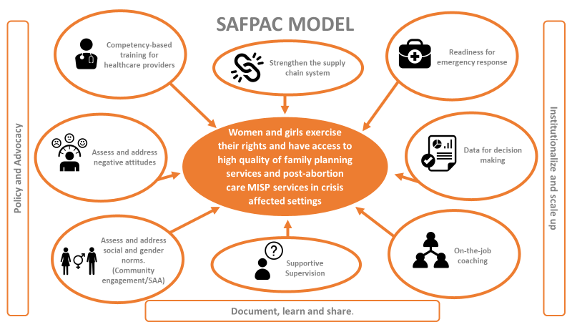
Supporting Access to Family Planning & Post-Abortion Care (SAFPAC_ in Fragile Contexts: Programmatic approach
Notes:
Mention DRC north kivu→ Kasai agility

Slide 27
Resources
SRHRiE section of CARE Emergency Toolkit
CARE Sharepoint: https://careinternational.sharepoint.com/sites/Global-Humanitarian-Hub/SitePages/Sexual-Reproductive-Health-&-Rights.aspx
Core documents:
IAWG MISP cheat sheet
CARE’s demystification of the MISP
CARE’s Logistics Notes
CARE’s Public Health in Emergencies summary
SRHR additional questions for Rapid Gender Analysis
SRHRiE Minimum Commitments for gender and Inclusion

Slide 28
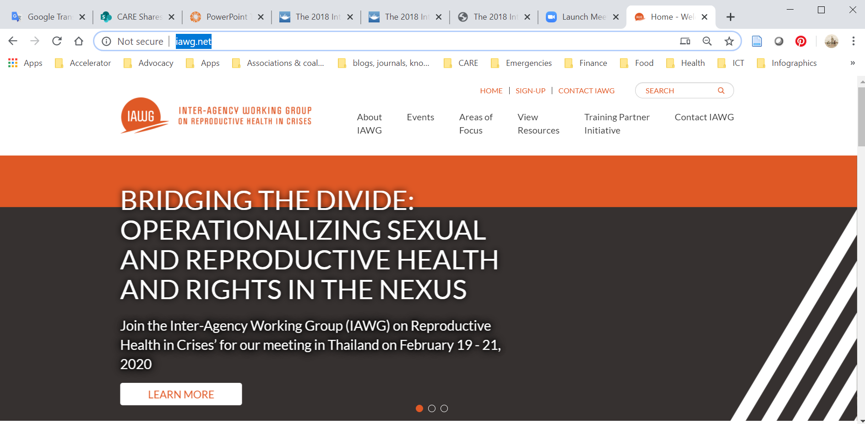
External Resources

Slide 29
Did you know?
Partnerships:
CARE has a global MOU with UNFPA
CARE has a global MOU with International Planned Parenthood Federation
CARE collaborates closely with Family Planning 2020 including in crisis settings
Global Team:
In addition to Sector Lead for SRHRiE (Anushka Kalyanpur)
Focal point for supply chain/ logistics (Elizabeth Noznesky)
Focal point for public health in emergencies & disease outbreaks (Allison Prather)
SRHR Regional Approaches Lead (Jimmy Nzau) and focal for each region (insert relevant regional focal point).
RRT: CARE has an SRHRiE Rapid Response Team member
Feel free to reach out for additional information!

