Slide 1
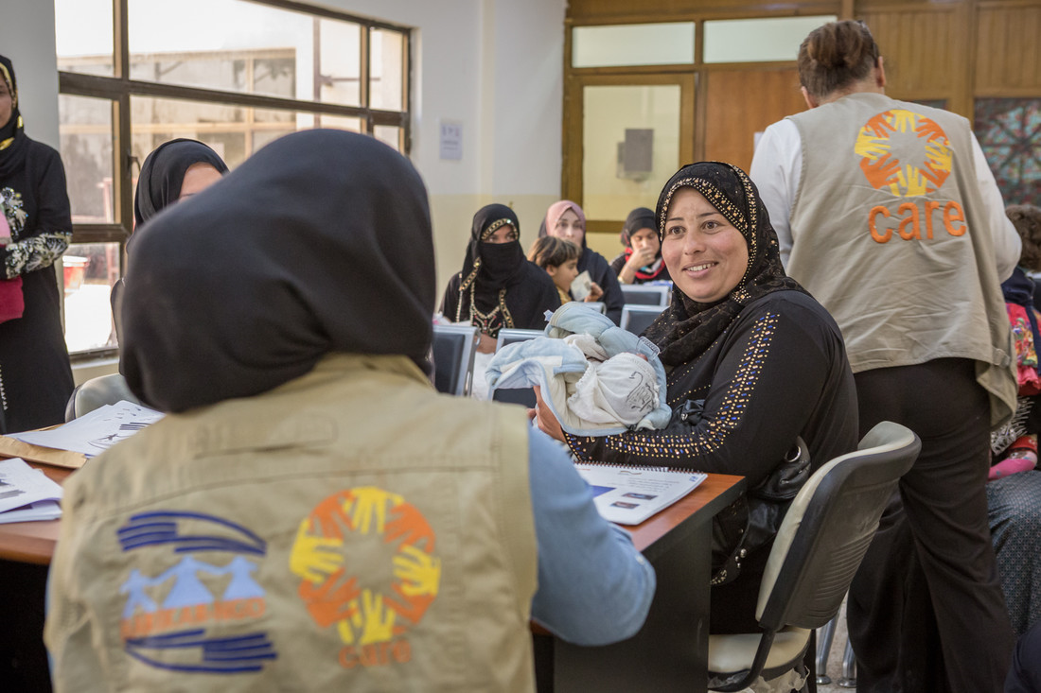

SRHRiE Minimum Commitments
for Gender & Inclusion
Notes:
Total time suggested: 2.5 – 3 hours

Slide 2
Orientation to the Minimum Commitments
Core Concepts within the Minimum Commitments
CARE’s approach to Gender in Emergencies
The Minimum Commitments
  Why we have them
  The 5 Commitments
Operationalizing the Minimum Commitments: Self-Assessment
Monitoring the Minimum Commitments
Implementing the Minimum Commitments via Operations & Programs
Notes:
Suggested time for each:
Core Concepts within the Minimum Commitments – 30 min
CARE’s approach to Gender in Emergencies – 15 min
The Minimum Commitments – 20 min
Why we have them – 5 min
The 5 Commitments – 15 min
Operationalizing the Minimum Commitments: 1 hr 15 min
Self-Assessment intro – 10 min
Group work for self-assessment – 45 min
Share out – 20 min
Monitoring the Minimum Commitments – 20 min

Slide 3
Core Concepts
Gender and SRHR in Emergencies

Slide 4
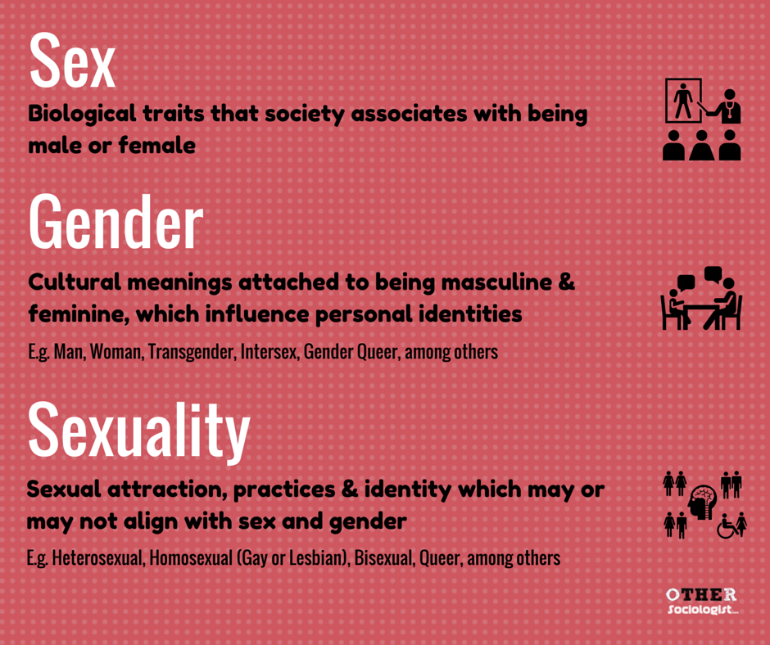
Gender vs. Sex
Notes:
While we talk a lot about sex and sexual health, let’s start with the difference between sex, sexuality and gender.
READ DEFINITIONS. ASK FOR EXAMPLES OF EACH.

Slide 5
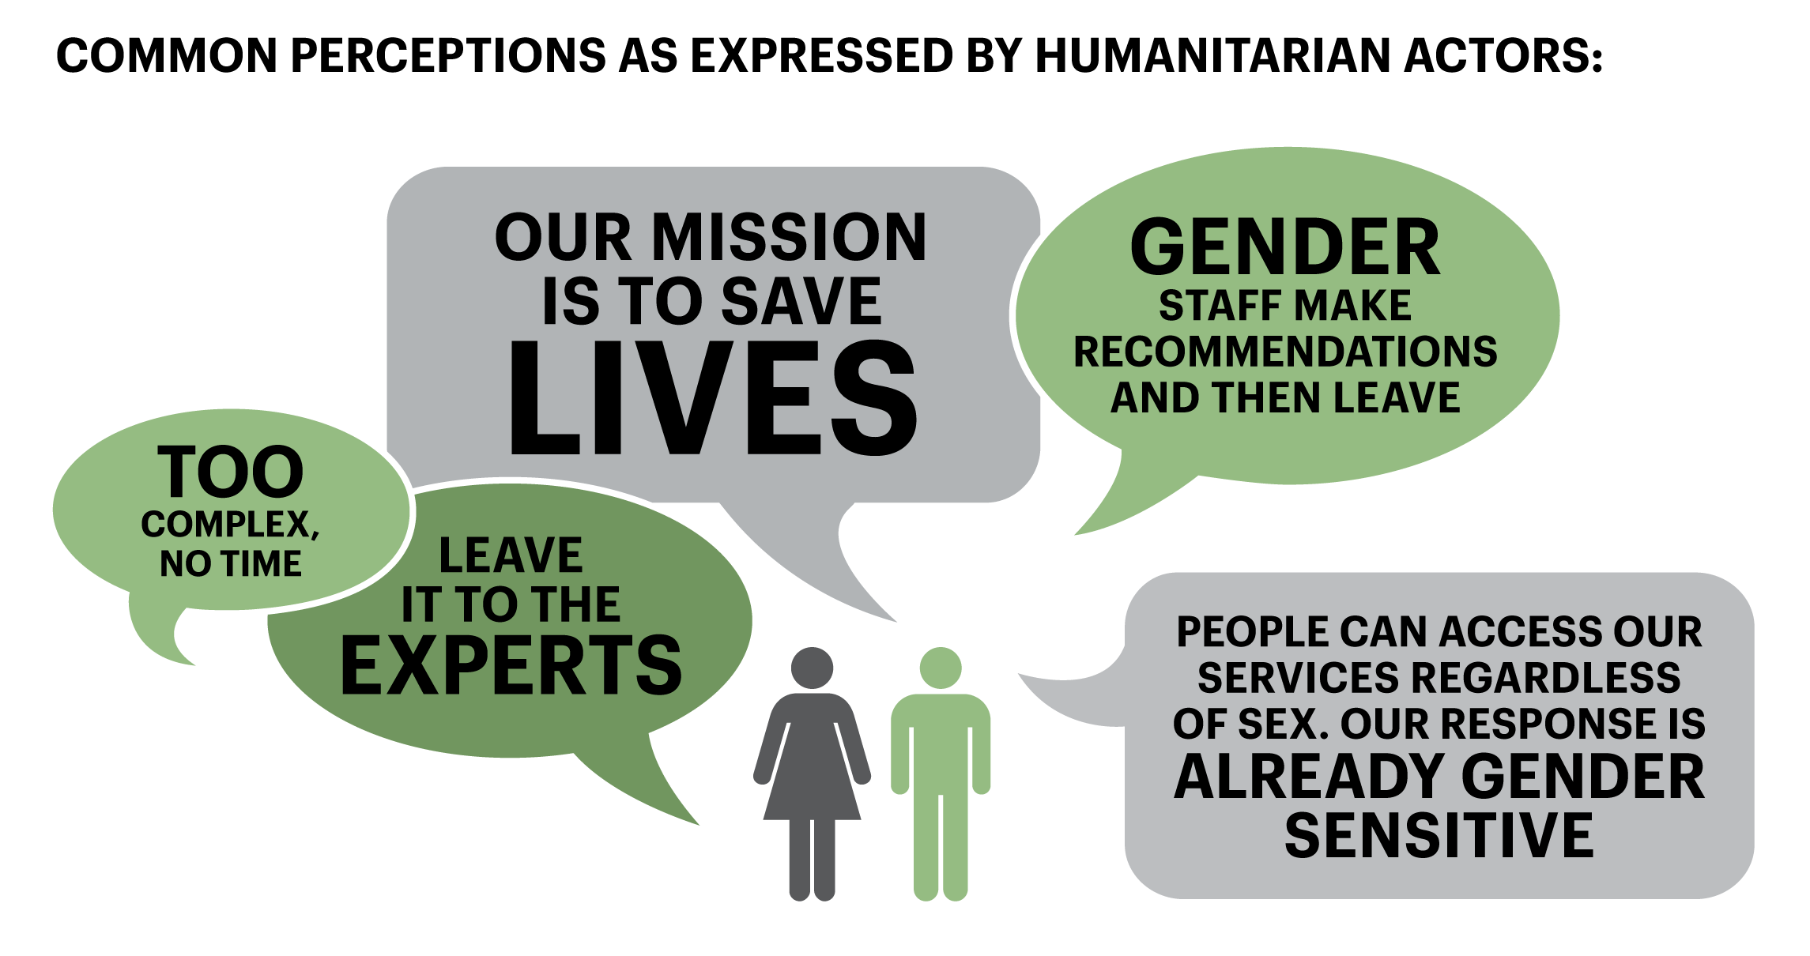
Common Perceptions Regarding Gender Integration as expressed by Humanitarian Actors:
Notes:
Do any of these reflections sound familiar?
Why might some people feel this way about gender integration?

Slide 6
Why focus on gender in emergencies?
“It is widely accepted that disasters, both natural and man-made, impact women, girls, men and boys differently, with the level of vulnerability and gender equality being key determinants of which groups are worse affected. […] in general women and girls are far more likely to die in a disaster at an earlier age.”
‘Empowering women and girls affected by crisis’ report
Our activities and approach during a humanitarian response can increase and reinforce, or reduce, existing inequalities – especially those that have changed or shifted due to the crisis itself.
Integrating gender into every stage of a response, including how power and gender have shifted, is therefore a core part of CARE achieving our humanitarian mandate and effective programs.
Notes:
Crises have different impacts on women, girls, boys and men. People face different risks based on their age, sex and gender. CARE also recognizes that gender intersects with other forms of diversity which can exacerbate unequal power relations e.g. characteristics such as race, caste, ethnicity, sexual orientation and disability among others, which can effect how people prepare for, respond to, recover from and are impacted by crisis. Recognizing these differences that exist within and between communities, will often highlight unique concerns and bring different perspectives, experiences, and solutions, to the challenges faced by communities. Based on this, the need for assistance and protection will vary.
Our activities and approach during a humanitarian response can increase and reinforce, or reduce, existing inequalities. Integrating gender into every stage of a response is therefore a core part of CARE achieving their humanitarian mandate.

Slide 7
Rapid Brainstorm:
Gender + SRH + Emergencies
How do people’s gender affect their ability to fulfill their right to sexual and reproductive health?
How does an emergency affect people’s ability to fulfill these rights?
  How might changes in the physical environment affect SRHR for girls, boys, women and men?
  How might changes in safety and security change affect SRHR for girls, boys, women and men?
  How might changes in mobility results in people’s acceptance of, access to, or utilization of SRH services?
  How might changes in people’s income or livelihoods due to the emergency affect SRHR for girls, boys, women and men?
Notes:
See if you can’t get an answer on the 2nd question for girls, boys, women and men SEPARATELY (as opposed to “women and girls” or “men and boys are affected more when…
Possible probe on mobility: how do communities become even more conservative towards SRH?
Ex. we saw in CxB where women and girls often couldn't walk around/ access services with being accompanied by a man but also b) in many places, we see women who previously may not have worked outside the household now engaging in livelihood and other activities outside the HH, increasing their mobility).

Slide 8

Effects of Emergencies on SRHR
Women and girls are at increased risk of:
  Rape and sexual violence
  Child, early and forced marriage
  Human Trafficking
  Unintended pregnancy
  Unsafe abortion
  Complications during pregnancy and delivery
  STI and HIV acquisition
Notes:
from IPPF presentation

Slide 9

Whose SRHR is affected most in eemergencies?
Adolescents
LGBTQIA
People living with disability
People living with HIV
Notes:
from IPPF presentation
Ask participants – how might each of these groups be more affected than people outside of this group?

Slide 10
Gender & Inclusion
Why are people included? Why are people excluded?
Discrimination against women persists in every corner of the world, but the experience is shaped by interwoven factors that build upon and extend beyond the gender element. These factors include race, socioeconomic class, age, sexual orientation, disability and more.
Capacity4dev
https://europa.eu/capacity4dev/articles/reality-intersectional-factors-gender-inequality
Intersectionality suggests that each one of us lives as in a web, where different strands of power, identity, ability & choice intersect to shape the conditions in which we live
Slim 2018
Notes:
from IPPF presentation

Slide 11
Barriers to Integrating Gender in SRHR Response
Lack of experience designing and implementing gender sensitive programming:
Staff are often overwhelmed by immediate needs related to service rollout and implementation
Staff often think gender mainstreaming requires a specific set of knowledge and skills only possessed by gender specialists.
Resistance to, and misconception of, gender integration:
That gender sensitive programming is a ‘luxury’ reserved for recovery and development interventions
Notes:
WASH MC Presentation

Slide 12
However….
“…empowering women and girls is a critical pathway to reduce vulnerability and poverty for the whole community, as well as being essential for achieving gender equality.” CARE International Humanitarian and Emergency Strategy 2013-2020 (p.4).
Gender equality and women’s voice is central to CARE’s approach in emergencies. As a rights based organization, CARE seeks to promote equal realization of dignity and human rights, and the elimination of poverty and injustice for all genders and ages.
Gender-sensitive approaches to SRHR are needed, feasible and effective including in humanitarian settings"
Notes:
Humanitarian crises offer a ‘window of opportunity’ to transform unequal gender relations and shift harmful gender norms. Knowing this, CARE works along a continuum to ensure that, at the very least, emergency responses are gender sensitive, but strive to be, gender transformative.
Essential to achieving this, is a focus on women and girls’ empowerment, as well as engagement of men and boys.
So how do we achieve our mandate and enhance gender integration?
Citation: Emergency Toolkit

Slide 13
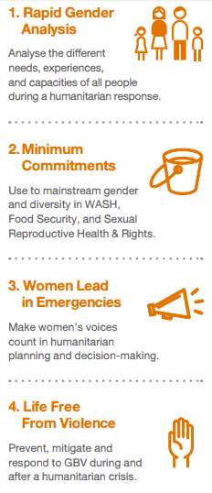
CARE’s Approach to Gender in Emergencies
Notes:
CARE’s approach to gender in emergencies focuses on mainstreamed, integrated and targeted actions and approaches. The approach focuses on 4 key areas (see graphic). These are outlined in CARE’s Gender in Emergencies Guidance note and are summarized below.
Rapid Gender Analysis (RGA): An RGA provides information about the different needs, capacities, and coping strategies of women, girls, boys and men in a crisis situation. It does this, in part, by examining the roles and relationships between women, girls, boys and men. An RGA is built up progressively, and provides an initial but incomplete analysis of gender relations in an emergency.
Minimum commitments for technical sectors: Ensuring gender is mainstreamed and integrated throughout all steps of the humanitarian program cycle helps to ensure that adequate and efficient services and assistance is provided, with attention to users’ safety, dignity and equal access. Minimum Commitments are people-centered commitments that aim at improving the quality and efficiency of response programmes, and ensuring that key issues such as gender, gender-based violence, child protection, disability and age are taken into consideration by all partners.
Women Lead in Emergencies: Gender equality in humanitarian programming is most effectively achieved if women and girls actively participate, and are empowered to choose how to participate, in decisions on how to meet their needs.
A focus on women’s equal voice, leadership and participation aims to transform the root causes of poverty and injustice, to save lives and increase gender equality. Particular efforts are made to reach marginalized women and girls, including women with disabilities, indigenous women, elderly women, and women of diverse sexual orientation and gender identity, engaging them as active partners, and building on their needs and capacities.
Life free from violence: In an emergency GBV is exacerbated, and vulnerabilities and risk increase. Preventing and responding to GBV in emergencies (GBViE) is a life-saving activity that requires a prioritised response and is mandatory in CARE programming.

Slide 14
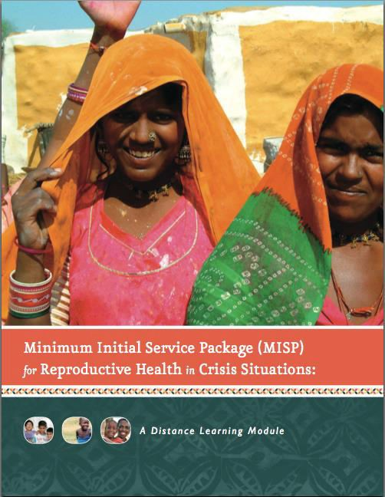
The Minimum Initial Services Package
Minimum: Basic and lifesaving SRH services provided
Initial: Acute phase in emergencies – no need for assessment
Services: health care for the population
Package: Activities, supplies, coordination, planning
Notes:
Apart from CARE’s Gender in Emergencies guidance, standards and tools, our SRHR responses heavily utilize the MISP. In response to the clear need for sexual and reproductive health services in humanitarian emergencies, the international community developed a set of minimum standards for response- the Minimum Initial Service Package or MISP for SRH.
The MISP defines which SRH services are most life-saving, while protecting the right to life with dignity, particularly for women and girls, in humanitarian settings.
All services should be in place within 48 hours of the onset of an emergency, and build to more comprehensive services as soon as possible, ideally within 3-6 months.
The services included in the MISP are based on well-documented evidence of SRH needs in humanitarian settings and World Health Organisation normative standards. Thus, we do not need an in-depth needs assessment to tell us which SRH services to implement. However, some initial situational, demographic and health information is needed to optimize delivery of the MISP.
It is important to note that the components of the MISP form a minimum requirement and should be implemented in all circumstances. Even where other components of SRH care are available, we should ensure that the MISP services are first implemented and available to all as they are most life-saving. As soon as possible, and certainly within 3 months, humanitarian stakeholders should expand services towards comprehensive SRH service delivery.
The MISP for SRH is the standard within the humanitarian sector. The priority activities of the MISP are included in the Sphere Minimum Standards in Humanitarian Response.
These dynamics have a profound impact on SRH services and outcomes. For example:
Women and girls’ risk of sexual violence may increase because of breakdown in societal structures, displacement overcrowding, and disruption of legal services.
The lack of access to information and services combined with high population density and increased risk of sexual violence can increase risk of unintended pregnancy, unsafe abortion, and STI/HIV transmission.
The inability to reach health facilities or skilled workers, and increased risk of malnutrition and communicable diseases during crisis can make delivery unsafe, and increase risk of pregnancy complications. Indeed, when health services are disrupted or impossible to access, complications in pregnancy/childbirth can quickly become deadly.
Crisis situations can lead to an increase in risk-taking behavior which increases risk of having unintended pregnancies and contracting STIs and HIV infection.
Crises have a disproportionate impact on people with disabilities.
Adolescent SRH needs and adolescents’ access to SRH services can be particularly complicated in crisis and are often restricted in stable times.
Families and communities are separated.
Mechanisms for protection and service delivery such as health, education, and police are disrupted.
Community support systems and protection mechanisms break down.
Existing power dynamics (based, for example on age or gender) may become more prominent during a crisis and underserved groups can have less access to information and services.
The need for sexual and reproductive health information and services do not stop because of a crisis.
4% are pregnant, 15% will have complications pregnancy

Slide 15
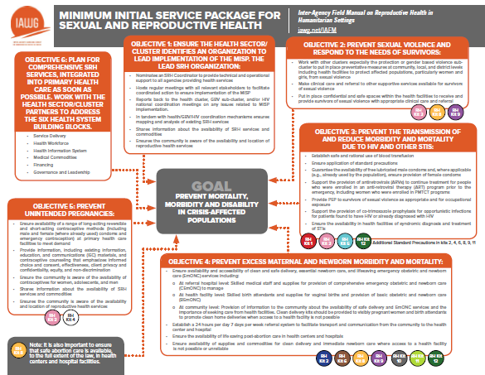
MISP 2019 Objectives

Slide 16
QUESTIONS?

Slide 17
SRHRiE Minimum Commitments for Gender & Inclusion
What are they? How do we use them?
How do we monitor them?

Slide 18
Importance of the Minimum Commitments
As SRHR actors working in emergencies it is our responsibility to understand and deliver services that assist all parts of the population while placing no one at risk.
Without properly understanding the community level social and gender norms and dynamics, we’re not able to fulfill this mandate
Providing sexual and reproductive services alone will not guarantee they will adequately and effectively meet everyone’s needs.
Only a people centered, participatory approach at all stages of the response can help ensure that adequate, inclusive and efficient services are provided.
Notes:
SRHRiE MCs for Gender and Diversity_Guidance for…eam Leads
The response must be designed and delivered in a way that takes into account the unique and multiple needs of the users, in a way that addresses existing power dynamics

Slide 19
What are the MCs?
5 minimum commitments to make gender sensitive and inclusive programming tangible, simple and practical.
Cover core actions which teams should systematically reflect on, contextualize and apply in their response.
Developed via a participatory process with SRHR practitioners working in humanitarian settings in strong the GiE team – not by gender specialists alone
Notes:
SRHRiE MCs for Gender and Diversity_Guidance for…eam Leads
The minimum commitments tool, used by other sectors such as WASH, has had notable success in many countries in improving the quality and efficiency of the response. The SRHR minimum commitments build on these experiences. The commitments are generic enough that they can be applied in the various contexts where CARE operate. They are in line with the MISP and constitute a minimum set of core actions and/or approaches to be applied by all humanitarian country teams. They focus on improvement of current approaches (How teams operate) rather than on drastic programme reorientation. This is why they should not be perceived as generating an additional workload.

Slide 20
How were the MC’s developed?
1. The needs or barriers certain groups may face based on gender, age or diversity.
2. On an understanding of gender dynamics that may lead to vulnerabilities.
3. An analysis of existing challenges to the quality and appropriateness of SRH assistance provided – or what SRHR teams don’t do well
We do not want to re-state again what is already known (e.g. in SRH, focus on women of reproductive age) but about calling the attention on important issues that may be overlooked
Notes:
They were developed using 3 types of analysis:
1. For firs tpoint: The groups that have been prioritized are:
-Adolescent girls and boys
-Pregnant and lactating adolescent girls
-Sexual minorities
- Persons with a mental or physical disability
2. For 2nd point: For SRHR, we are mainly focusing on men – they are husbands, fathers, partners, and decision-makers, especially related to decisions on contraceptive use.
3. For 3rd point: As you will see in the commitments, the analysis has found that we can do better analysing and responding to power dynamics within the home and within the community, tailoring interventions to the unique and multiple needs of adolescent girls and boys and other hard-to-reach groups, and Monitoring equitable access to SRH services needs

Slide 21

SRHR MC’s for Gender and Inclusion
DESIGN
ASSESSMENT
Develop your programmes for and with adolescent girls and boys, women and men, including those most marginalized
Analyze how power dynamics affect adolescent girls’ and women’s access to services to inform the targeting and the design of your support
IMPLEMENTATION
Provide quality services to all, overcoming the barriers that pregnant and breastfeeding adolescent girls and those most stigmatized face
ACROSS THE RESPONSE
Engage men and boys to champion the use of family planning methods
and to promote respectful and nonviolent relationships
RESPONSE MONITORING
Monitor equitable access to services and set confidential and responsive feedback & complaint mechanisms
5 commitments
Notes:
These 5 commitments you see here in the pink boxes are the first part of the tool.
The commitment you see here cover core actions or approaches which sector members should systematically apply in their operational response at each phase of the project cycle.
These commitments reflect key priority issues in the SRHR sector.

Slide 22
Commitment 1: Assessment
Ensuring equal participation of women and men
Participation is a right
Allows and fair and impartial approach
There is no homogeneous community: humanitarian crises affect girls, boys, women & men; their needs are different
OUTPUTS
SRHR assessments include an analysis of the power dynamics within the home and the community on use of contraception and access to services
Services are designed so as to seek the engagement of those who have a decision-power and so as to address the barriers females may face in accessing assistance
Different roles and responsibilities in family care , in the social and economic spheres
Notes:
1: Analyze how power dynamics affect adolescent girls’ and women’s access to services to inform the targeting and the design of your support

Slide 23
Commitment 2: Design
Develop your programmes for and with adolescent girls and boys, women and men, including those most marginalized
OUTPUTS
Separate consultations with adolescent girls and boys, women, men, including sexual minorities, inform the design of SRHR services, allowing to provide adequate, dignified and safe assistance
Services are accessible to those with limited mobility
Notes:
2: Develop your programmes for and with adolescent girls and boys, women and men, including those most marginalized

Slide 24
Commitment 3: Implementation
Provide quality services to all, overcoming the barriers that pregnant and breastfeeding adolescent girls and those most stigmatized face
OUTPUTS
An increased number of pregnant and lactating adolescent girls, including those who are housebound, have access to information and care
Services provide non-discriminatory and dignified assistance to the most hard-to-reach groups, including sexual minorities and sex workers
Notes:
3: Provide quality services to all, overcoming the barriers that pregnant and breastfeeding adolescent girls and those most stigmatized face

Slide 25
Commitment 4: Response Monitoring
Monitor equitable access to services and set confidential and responsive feedback & complaint mechanisms
OUTPUTS
Baselines and M&E tools include the collection of sex and age disaggregated data on the access to SRHR services, including on how adequate users find the response
The country programme has set up a feedback mechanism with and for patients and takes timely corrective actions to address the access and quality concerns being raised
SRHR patients (girls, boys, women, men, including sexual minorities and persons with disability) know how to use the feedback and complaints mechanisms set up by the program
Notes:
4: Monitor equitable access to services and set confidential and responsive feedback & complaint mechanisms

Slide 26
Commitment 5: Across the Response
Engage men and boys to champion the use of family planning methods and to promote respectful and nonviolent relationships
OUTPUTS
Programme measures changes in adolescent boys and men’s perceptions and attitudes toward joint-decisions and shared responsibilities on family planning
An increased number of community and religious leaders take public positions in support to family planning and to equal and non violent relationships
Notes:
5: Engage men and boys to champion the use of family planning methods and to promote respectful and nonviolent relationships

Slide 27
QUESTIONS?

Slide 28
Operationalizing the
Minimum Commitments
THE SELF-ASSESSMENT

Slide 29
Purpose of the Self-Assessment Questionnaire
To help you reflect on how services are designed and delivered in a way that takes into account the unique and multiple needs of the users, in a way that addresses existing power dynamics.
To serve as a collective tool, with your partners, to address any existing challenge that may limit the access and use of services by ALL.
Notes:
This questionnaire should help country teams to understand how their SRHR response is complying with the commitments. The idea is not to evaluate or rank the quality of the programs, but to monitor them using a gender, age and diversity lens, taking corrective actions where necessary.
Before your project starts, you are encouraged to read the questions to understand what actions and approaches will require your attention.
Kindly fill in the questionnaire at the beginning, mid-implementation and at the end phase of your project.
Once completed, please send it back to the national SRHR coordinator who will compile, analyze and share back the country teams’ responses.

Slide 30
Completing the Self-Assessment Questionnaire
Fill in the questionnaire at the beginning, mid-implementation and at the end phase of your project.
Per project, identifying the ones that are performing well or less well in order to prioritize those that need support / guidance;
Per phase, identifying the phases where the problems lay and taking corrective actions to address the identified challenges.
Identify specific areas of support needed from within other staff in the CO, the global SRHRiE and/or GiE teams
Notes:
MISP & SRHRiE Minimum Commitments: Overview
When to fill it out: for this pilot, we ask that you fill this out as a team, dedicating that time to reflect and exchange on the quality and inclusiveness of their response
After the pilot, programs will fill this out in the middle of implementation and at the end phase of your project.
We also wish this will serve as a collective tool, with your partners, to address any existing challenge that may limit the access and use of services by ALL.

Slide 31
Assessment Section of Questionnaire
ASSESSMENT
Question related to commitment #↓ |  |  | Response (Yes, Partly, No, Not Applicable N/A) | Comments
1 | Have you discussed separately with women and men to understand who makes decisions within the home on issues such as use of contraception, child spacing, the number of children the family will have, delivery? | 1
2 | Have you identified with them who are the influencers, in the community, preventing or, on the contrary, supporting girls’ and women’s access to modern family planning methods and other SRH services? | 1
3 | Have you consulted separately adolescent girls and women about the specific constraints they may face in accessing services (For example, not allowed by their husband or father to use contraceptive methods, cultural, physical and security-related mobility restrictions, location or opening hours of services not convenient for them)? | 1
4 | Based on your analysis of existing power dynamics, is your support designed to sensitize boys and men, including community and religious leaders, to take joint decisions, to share responsibility on the use of contraception and to promote women and girls’ sexual and reproductive health, well-being and rights? | 5
Notes:
SRHRiE MCs Self-Assessment and Implementation Monitoring
How is the questionnaire structured?
The questionnaire contains 19 questions, structured into 5 parts: 1) General information, 2) Assessment 3) Design, 4) Implementation, 5) Response monitoring.
Each question refers to one of the 5 commitments. It should take no more than 20-30 minutes to fill it in, including comments to explain your answers or overall findings of the self-assessment process.
It is hoped that the questions on the assessment will help you reflect on how services are designed and delivered in a way that takes into account the unique and multiple needs of the users, in a way that addresses existing power dynamics. We are requesting that you respond to the questions as honestly as possible. Remember: this is not about ranking the quality of programs but a way to learn and monitor progress.

Slide 32
GROUP WORK
SELF-ASSESSMENT

Slide 33
Report Back
Was there a question or term you had trouble understanding?
How did your project score?
Which phases scored well and which did not?
What support, resources or guidance do you need to improve your score?

Slide 34
QUESTIONS?

Slide 35
Monitoring the Minimum Commitments
Traffic Light System
Action Planning

Slide 36
Why monitoring the MCs?
To monitor responses and programs using a gender, age and diversity lens
To show where corrective actions are necessary.
To help you monitor how well your field interventions apply the minimum commitments.
The idea is NOT to evaluate or rank the quality of the programs
Notes:
The MC’s as a monitoring framework should help your team to understand how the responses implemented in your country operations are complying with these commitments. The idea is not to evaluate or rank the quality of the programs, but to monitor them using a gender, age and diversity lens, taking corrective actions where necessary.
The monitoring form is used to:
Analyze individual projects to see if any program requires support or
Analyze multiple projects to see which phase of the programme cycle requires particular attention

Slide 37
Stages of Monitoring for MCs
Self-Assessment Questionnaire
Traffic light system
Action plan
Lessons Learned
Notes:
SRHRiE MCs for Gender and Diversity_Guidance for…eam Leads

Slide 38
Traffic Light System
For each phase:
All the answers to the questions are “YES” | GREEN
More than half of the answers to the questions are “YES” | ORANGE
Half or less of the answers to the question are “YES” | RED
Notes:
SRHRiE MCs Self-Assessment and Implementation Monitoring
Along with the 5 commitments and the self-assessment questionnaire, a traffic light system has been set up to monitor programs.
To use this system, you can review your answers to the assessment:
If you answered ‘yes’ to all the questions in a section, then that sections gets a green box
If you answered ‘yes’ to more than half of the questions in a section, then that section gets an orange box
If you answered ‘yes’ to less than half of the questions in a section, then that sections gets a red box

Slide 39
Reflecting on your portfolio
Example:
 | Assessment | Design | Implementation | Response monitoring
Example: Project U
Example: Project V | N/A
Example: Project W
Example: Project X |  |  |  | N/A
Example: Project Y
Example: Project Z
Notes:
SRHRiE MCs Self-Assessment and Implementation Monitoring
We can see that all the questions in the Assessment and Design sections of the self-assessment were answered ‘Yes’, however, Implementation received an orange box. That means that in the Implementation section, half or more of questions were answered ‘yes’. Response monitoring is the only section to be red, so that means less than half of the questions were anwered ‘yes’. The red and the orange boxes tell us which part of our response need to be reviewed and adjusted to make SRH services adequate and inclusive.
So you can do this for every program in your SRHR portfolio. If you have multiple, then you can compare programs against each other.

Slide 40
Action Plan
Gap Identified | Corrective actions | Resources needed | Lead | Timeline
Gaps at the assessment phase
Gaps at the design phase
Gaps at the implementation phase
Gaps at the response monitoring phase
Notes:
SRHRiE MCs Self-Assessment and Implementation Monitoring
Once your team is done with the self-assessment, there is an opportunity to analyze the results of the individual project by using the scoring matrix provided. The Action Plan table is provided to structure the team’s plan for addressing the gaps identified via the self-assessment. These gaps and then corresponding next steps are divided by phase of the program cycle.
For each phase covered in the self-assessment, note each question answered “No” or “Partly” and record them in the “Gaps identified” column. Then, brainstorm solutions in your team and use the cited resources below to identify corrective actions to address these gaps. For each gap and corrective action, identify resources needed or existing resources within the program to implement the action, who will lead this process, and when it will be started and completed.

Slide 41
Translating the MCs into Reality and Making Them
Standard Practice
Utilize the minimum commitments for an on-going dialogue
Ensure compliance with the minimum commitments is monitored during field visits.
Use the traffic light system to identify gaps and refer to the Outputs to identify required actions for a genuine translation of into practice
Include minimum commitments in partnership contract agreements
Notes:
MISP & SRHRiE Minimum Commitments: Overview
During the pilot, you and your team will use the self-assessment questionnaire and the traffic light system to see what part of your response or program needs more attention or adjustment.
But beyond these initial steps, as SRHR team leaders, you have an important role to play in ensuring that the MCs translate into reality and become standard practice.
Make the pilot process an on-going dialogue – pg. 2 has suggested questions to ask your team while doing the assessment
Ensure compliance with the minimum commitments is monitored during field visits. – if your team knows the commitments, each field visit can provide information on how staff are executing and complying
Use the traffic light system to identify gaps and refer to the Outputs to identify required actions for a genuine translation of into practice
Include minimum commitments in partnership contract agreements

Slide 42
Pilot Teams’ Feedback
Strengths:
  Easy to use
  Facilitates critical reflection on program activities
  Prompts thinking along specific points in the program cycle
  Encourages teams to consider the unique needs of specific groups
Areas to strengthen:
  Clarity on technical terms
  Importance of emphasizing thinking beyond traditional definitions and norms around gender
  Balance between meetings MCs vs changing programming
  Action planning needed
Notes:
MISP & SRHRiE Minimum Commitments: Overview
spend more time on this + look at tool: what is gap and how you want to go. idea to do better at all of it. reflection tool for your team. spend time on tool! examples of success. identifying steps you're working towards some of those, not a black and white, that's why grades

Slide 43
QUESTIONS?

Slide 44
Implementation of the
Minimum Commitments
Operational & Programming Opportunities

Slide 45
MCs for Team Leads: it starts with dialogue
The impact of the crisis sexual and reproductive health
Local gender and social norms and practices on sexuality, family planning and pregnancy
Decision making within the home on the use of contraceptive methods
Inclusive participation: giving voice to groups who might be frightened or unable to access our services,
Quality of services to meet dignity and privacy needs
What we do well and not so well: How do we address that?
Added bonus: drives lessons learnt and best practices, rooted on the implementation of the minimum commitments.
Notes:
The minimum commitments are a tool aimed at generating a collective reflection within the SRHR team as well as with its partners on how adequate and inclusive its response is. It is about ensuring that affected people are at the center of the interventions. This is why the process by which these commitments are introduced and promoted over time are of critical importance.
Using dialogue, build a shared vision among your SRHR team and with your implementing partners about the importance of developing programmes that are adequate, dignified and inclusive, and initiate a dialogue with them to make sure they aim to fulfil the minimum commitments. You can engage for each commitment in a dynamic discussion and take stock of your team’s and partners’ views and approaches. Some prompts for dialogue could center around:
1) “How well do our needs assessments capture the distinct impact of the crisis on women’s, men’s, boys’ and girls’ sexual and reproductive health?”
2) “Do we have sufficient understanding of the local gender and social beliefs, norms and practices on sexuality, family planning and pregnancy and how these impact girls’ and women’s access to services? “
3) “Do we understand who has a predominant say within the home on the use of contraceptive methods?”
4) “To which extent do we use this knowledge for the targeting and design of our interventions? Do we sufficiently seek the engagement of those who have a decision-power? How do we promote joint decisions and responsibilities?”
5) “How consultative are we when planning, implementing, and monitoring our interventions?”
6) “Is participation inclusive enough? Do we give voice to groups who might be frightened or unable to access our services, such as married adolescent girls, gays, lesbians or persons with reduced mobility?”
7) “Are our services of sufficient quality to meet dignity and privacy needs?”
8) “Do we have the right set of skills to provide supportive, confidential and non-stigmatizing support?”
9) “How do we ensure that we are on track with the quality of our interventions? Can female and male clients, including those most hard-to-reach provide feedback? Are complaints mechanisms in place?”
10) “Do we measure the effects of our interventions when it comes to enabling boys and men to engage in healthier, more equitable and non-violent relationships?”
11) “What do we do well and not so well? What are the challenges we are facing in providing services that are accessible and adequate to all? How can we address these? Do our current practices comply with the SRHR minimum commitments? What changes would it take?”

Slide 46
MCs for Team Leads: make mainstreaming a reality
BEFORE PROGRAMMING BEGINS
Ensure that your humanitarian strategy includes criteria for designing adequate and inclusive SRHR in emergency programming and that Country Office Emergency Response Team members are aware of the Minimum Commitments.
Include the Minimum Commitments in Emergency Planning & Preparedness workshops, the Gender Action Plan and M&E Frameworks.
Ensure that your project proposals grade two or above on the CARE’s Gender Marker
Notes:
SRHRiE MCs for Gender and Diversity_Guidance for…eam Leads
But beyond these initial steps, as SRHR team leaders, you have an important role to play in ensuring that the MCs translate into reality and become standard practice.
Pages 2-3 of the same Monitoring Form document lists a number of suggestions of what you can do in this respect. While we don’t expect you to do every one of these things in the next 4 months of the pilot, there are some quick wins that we suggest you consider:
Make the pilot process an on-going dialogue – pg. 2 has suggested questions to ask your team while doing the assessment
Ensure compliance with the minimum commitments is monitored during field visits. – if your team knows the commitments, each field visit can provide information on how staff are executing and complying
Use the traffic light system to identify gaps and refer to the Outputs to identify required actions for a genuine translation of into practice
Include minimum commitments in partnership contract agreements

Slide 47
MCs for Team Leads: make mainstreaming a reality
DURING PROGRAMMING
Provide adequate training so that operational staff and implementing partners understand what added value the minimum commitments bring to their interventions;
Use the Minimum Commitments to inform partner selection when deciding which local organizations to work with, when recruiting staff or when evaluating partners’ performance.
Include minimum commitments in partnership contract agreements
Notes:
SRHRiE MCs for Gender and Diversity_Guidance for…eam Leads

Slide 48
MCs for Team Leads: make mainstreaming a reality
ON GOING
Use the traffic light system and self-assessment throughout programming to identify the required actions for a course corrections
Once you have an Action Plan, ensure resources are available that can enhance the quality of the SRHR response
  Tools: IASC gender handbook, CARE Rapid Gender Analysis Toolkit, Inter-Agency Field Manual for SRH in crisis-settings, SRHR in Emergencies participatory tools
Make the IASC Gender Online Course “Different Needs, Equal Opportunities” mandatory (at least Introduction + health section of the course)

Slide 49
QUESTIONS?
Doubts? Suggestions? Excitement?

